Slide 1
Countering Disinformation
Understanding how it works, how to identify it, and the best ways to respond to protect our democracy and voting rights.

Slide 2
For Trainers: What’s in this slide deck?
An introduction explaining the connections between science and democracy
Links to a series of six three- to five-minute videos explaining how disinformation works and how to effectively respond to it. Note that you will need an internet connection to show these videos.
Each video segment is followed by key takeaways and an optional discussion topic or activity. Select which activities you’d like to include based on your time and audience and adjust the presentation accordingly.
For more information and background, supporting research, studies, and references are included in the notes for several of the videos.

Slide 3
For Trainers: How to use these slides
Based on your audience’s interest, choose activities to explore in-depth
Adapt this presentation accordingly based on your time and audience
Review and adapt the notes for each slide to help inform your presentation
If you haven't yet done so, take the Science Rising Training!
Suggested agendas:
Less than 20 minutes
Intro
Why engage? (science and democracy intersection)
Common pitfalls and how to address them
Q&A
Disinformation and voter suppression
Call to action
20-40 minutes
Intro
Why engage? (science and democracy intersection)
Understanding disinformation
Activity: response discipline
Common pitfalls and how to address them
Q&A
Disinformation and voter suppression
Call to action
40+ minutes (recommended)
Intro
Why engage? (science and democracy intersection)
Understanding disinformation
Activity: response discipline
Common pitfalls and how to address them
Building your narrative
Q&A
Activity: narrative building
Disinformation and voter suppression
Call to action

Slide 4
Introduction
[Your Name/Title]
[Your Organization or Group]
[Insert your photo and/or your group’s logo]
A
presentation
Notes:
Introduce yourself, your organization, and Science Rising.
Intro Science Rising: Science Rising is a nationwide nonpartisan movement fighting for science, justice, and equity in our democracy. This network of community and campus groups supports and inspires the scientific and academic community to participate in our democracy, connect with their peers and communities, and counter the disinformation that pollutes our society and democracy. In pursuit of this vision, Science Rising is training and empowering a team of leaders to teach others about the crucial issues facing our democracy–and how we all can and should get involved to make a difference. I’m excited to be part of Science Rising and hope that you will be too!

Slide 5
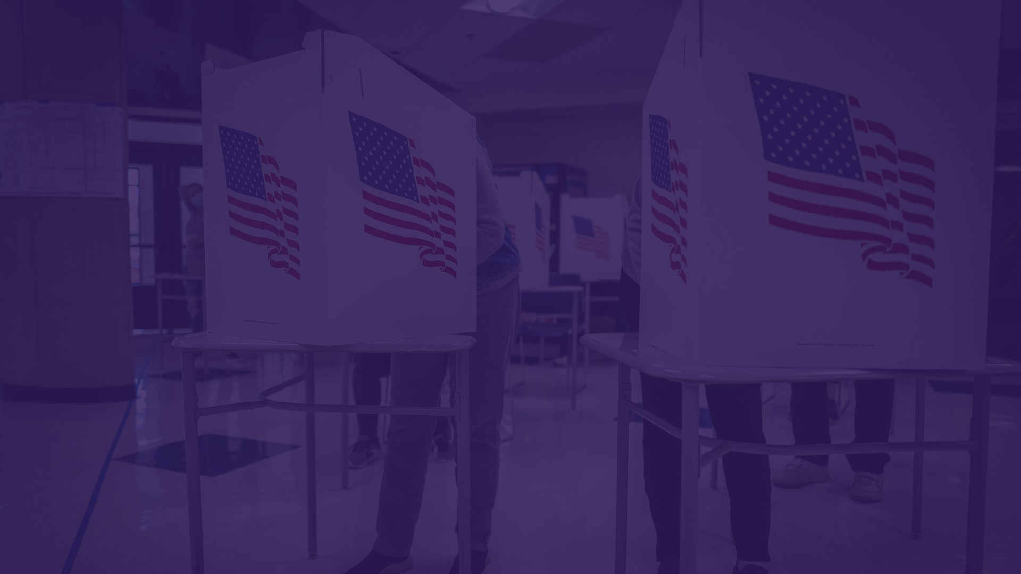
Science and Democracy
Notes:
To kick off this training, I wanted to talk about the intersection of science and democracy. As science advocates, it’s not enough to push for science-based solutions to public health and environmental challenges—we also need to protect, and sometimes even fix, our democracy so those solutions become more achievable.
You can’t have science-based policies and evidence-based solutions if the entire system is broken.
Scientists and science advocates have a critical role to play in fixing the system.

Slide 6
Scientists and Democracy
Facts and data are not enough. We also need to protect, and sometimes even fix, our democracy so we can achieve science-based solutions.
We need more people to vote—but we also need voting to be more accessible and with fairer representation for all. ​
Notes:
MELISSA
As science advocates, it’s not enough to push for science-based solutions to public health and environmental challenges—we also need to protect, and sometimes even fix, our democracy so those solutions become more achievable.​ You can’t have science-based policies and evidence-based solutions if the entire system is broken. Scientists—and that includes STEM students--need to help fix the system. ​
​
Scientists can help by:​
Countering disinformation that threatens our democracy, seeks to suppress voter turnout, and puts our election and voting systems at risk.
Building the case for evidence-based democracy reform measures through research and analysis. You don’t have to be an expert in elections to be able to encourage elected officials to use research and evidence to inform how we reform our democracy. ​
Advocating with decisionmakers in favor of policies that can make democracy reform a reality. As a constituent you have the right to talk to your elected officials about the issues that matter to you. Talk to them about democracy reform, voting rights, and making voting accessible. ​
Supporting community partners in their work to strengthen democracy on the ground. BIPOC communities, low-income communities, and other historically marginalized communities have been organizing and fighting back against voter suppression long before it made headlines. Find out what’s happening in your community and look for ways you can support them. ​
​
Resource: https://ucsusa.org/take-action/healthier-democracy​

Slide 7
Scientists and Democracy
GOOD NEWS! Scientists and the scientific community are participating in our democracy at record levels.
Notes:
Even though we face massive challenges to fixing the systems and institutions within our democracy, we have some good news. Scientists are getting involved, and STEM students are turning out to vote at higher rates than ever before! ​

Slide 8
Voting Rates by Field of Study
STEM voter turnout increased dramatically in 2020
But STEM voters still lag behind the average student turnout
+16% +11% +13% +15% +14% +11%
2020
Average
Turnout
66%
Notes:
In 2020, voter turnout hit record levels. 66.8% of the voting age population voted in 2020, an increase of 5.4% over 2016. ​
Importantly, student voter turnout also increased dramatically in 2020 over 2016. Overall, the national student voting rate in 2020 increased by 14 percent above 2016 levels, reaching 66% in 2020. ​
Thanks to the National Study of Learning, Voting, and Engagement, out of Tufts University, we have student voter turnout breakdowns by fields of study. Some of you may have heard that STEM students have the lowest voter turnout rates of any field of study. Well, I am pleased to share that we saw double-digit increases in voter turnout across all STEM fields in 2020. This includes: ​
16% increase in agriculture and natural resources. ​
16% increase among engineering students ​
13% increase in students studying healthcare ​
15% increase among natural sciences and math students ​
14% increase in psychology students ​
And 11% increase among students in technical fields ​
You may also notice that some of these fields are still lagging behind the average student turnout rate of 66%. We certainly still have work to do increasing voter engagement among STEM students—but we’re here to change that!
​
Resource: https://idhe.tufts.edu/nslve/2020

Slide 9
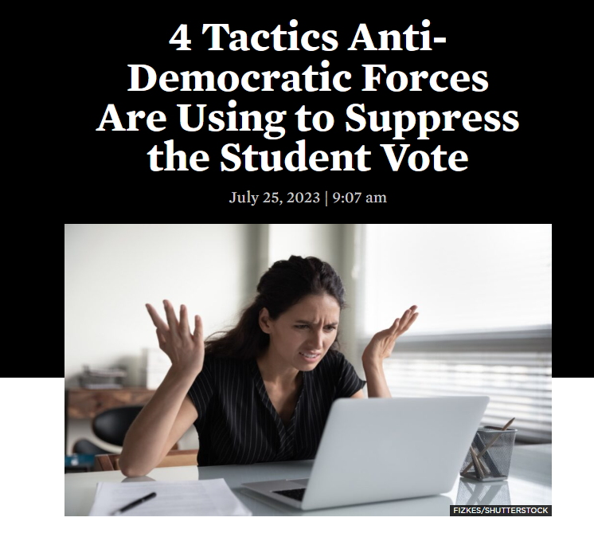
Anti-democratic forces are aware
Notes:
At Science Rising, we’re pretty fired up by the positive trends around student voting. However, antidemocratic forces are also paying attention to these trends—and they’re pushing back. From creating barriers to student voter registration, more restrictive voter ID laws, limited access to campus polling places, and restricting early voting and vote by mail, efforts to suppress student voting are increasing. That’s why countering disinformation around voting is a key piece to building a stronger democracy.
​
Resource: https://blog.ucsusa.org/ingrid-paredes/4-tactics-anti-democratic-forces-are-using-to-suppress-the-student-vote/

Slide 10
Overview: Countering disinformation
We’ll be sharing and discussing 6 short videos:
Intro: What is disinformation and how its used
Repairing harm and rebuilding trust
Response discipline
Pitfalls to avoid
Addressing common pitfalls
Building your narrative
Plus a closing discussion on disinformation and voter suppression
Notes:
**Presenter: edit this slide to only include the sections you'll cover in your training.
Looking at the intersection of science and democracy, it’s not enough to provide up-to-date, accurate information. It also means working to counter the bad actors who deliberately spread disinformation--about voting and our elections, but also about climate change, COVID, and so many other critical issues that you may be working on.
To help you effectively counter disinformation, we have a series of 6 short two- to four-minute training videos to share and discuss. These videos feature and were developed by Sabrina Joy Stevens in collaboration with the Union of Concerned Scientists. Sabrina is a communications expert and strategist who has spent years working on and teaching others how to most effectively counter disinformation. You can learn more about her work at https://www.sabrinajoystevens.com/.
We will hold space for questions at the close of the training. Please write them down along the way and ask those remaining unanswered at this point.

Slide 11
Challenges of today’s workshop
Notes:
This presentation and training will likely challenge many of your assumptions and even past behaviors in countering disinformation.
It’s never easy to hear that you may have been unwittingly manipulated to do things that are not only ineffective, but may even be counterproductive toward advancing progress on the things you care about.
Please stay open to self-reflection today, keep an open mind, and know that the tactics and recommendations shared in this presentation today are backed by science and research.

Slide 12
What is disinformation and how is it used?

Slide 13
Notes:
Background, context, and supporting science and research for reference.
From Sabrina Joy Stevens:
Note on overall approach
To maximize the applicability of what I present to a wide variety of people across a wide variety of topics and settings, I employ logic-based inoculation in my counter-disinformation trainings. That means that I explain common tactics and techniques (rather than specific people, arguments, or content) bad actors typically use to manipulate the public. My goals are to model an effective inoculation technique participants can use with their colleagues and communities, help participants identify disinformation in a broad range of real world circumstances, and help them craft effective narrative interventions against it. For more on the effectiveness of logic-based inoculation, also called logic-based prebunking, see:
John Cook, Stephan Lewandowsky, Ullrich K. H. Ecker (2017). “Neutralizing misinformation through inoculation: Exposing misleading argumentation techniques reduces their influence.” PLoS ONE 12(5): e0175799
First Draft: A guide to prebunking: a promising way to inoculate against misinformation (2021)

Slide 14
Key takeaways: What is disinformation and how is it used?
Disinformation = false or misleading information that bad actors intentionally spread to manipulate people.
Bad actors = political and economic actors who hoard power and wealth by manipulating people into taking actions against our individual and collective best interests.
Bad actors use disinformation as part of 3 manipulation tactics:
Divide and Conquer
Mislead and Misdirect
Overwhelm and Exhaust
Notes:
To highlight some key takeaways…
Misinformation and disinformation are not the same.
Misinformation happens when false information is shared out of ignorance, or by error.
In contrast, disinformation is DELIBERATE.
Another helpful way to think about this distinction: “Misinformation is an honest mistake. Disinformation is neither.”
Some people, interest groups, and organizations benefit from people not knowing the truth. And they create or spread untruths—or simply don’t bother to set the record straight—for their own personal, financial, or political gain.
Three common manipulation tactics that are used are divide and conquer, mislead and misdirect, and overwhelm and exhaust.

Slide 15
Activity: Disinformation in Your Life
Consider the following questions:
What are some examples of disinformation you’ve seen or experienced?
Have you seen or experienced any of the three manipulation tactics used by bad actors?
Divide and Conquer
Mislead and Misdirect
Overwhelm and Exhaust
Notes:
PRESENTERS: Adjust this activity according to your audience and available time. It can be an individual exercise, a group discussion and share, or a small group/breakout room activity.
Have you seen or experienced any of the three manipulation tactics used by bad actors? ​
Divide & Conquer​
Mislead & Misdirect​
Overwhelm & Exhaust​
(These examples will be helpful for exercises coming up later on in the training.)
​

Slide 16
Repairing harm and rebuilding trust

Slide 18
Key takeaways: Repairing harm and rebuilding trust
Facts alone have no power if the people we’re sharing them with don’t trust that we’re telling them the truth.
People don’t care what you know until they know that you care.
Sometimes you may not be the best messenger. Consider developing relationships and sharing resources with trusted messengers in the communities you’re trying to reach.

Slide 19
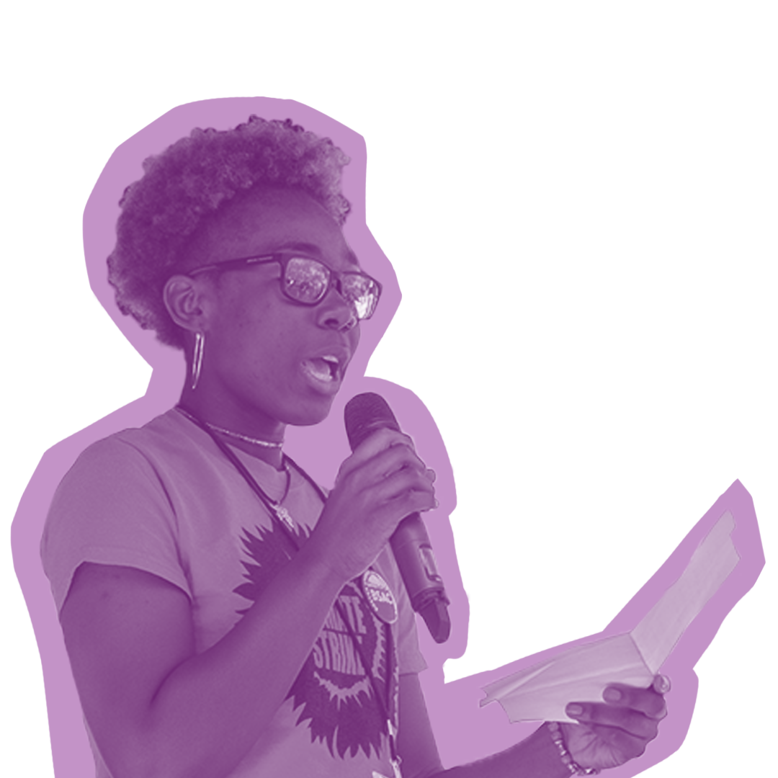
Activity: Repairing harm and rebuilding trust
To establish trust in individual conversations, it’s important to focus on these five techniques:
Keep a calm, non-judgmental attitude
Prioritize empathy over expertise
Look for points of connection
Look for and acknowledge underlying concerns
Use your expertise to explain the truth in a way that speaks to underlying concerns
Using the techniques outlined above, think through and practice with a partner or small group an individual conversation focused on countering a specific point of disinformation that somebody may believe to be true.
Notes:
PRESENTERS: This activity works best in groups of two. Have the audience pair with the person sitting next to them, or set up small two-person breakout rooms. Have the groups practice using these five techniques responding to the statement:
“The election was stolen because of voter fraud.”
I especially want you to focus on #s 1-4. Take 3min per person in each pair.
[Announce the half-way mark and when time is over]
[60sec] Which did you find most challenging to practice in your response? Raise you hand if…
“Keep a calm, non-judgmental attitude” was most challenging?
“Prioritize empathy over expertise”?
“Look for points of connection”?
“Look for and acknowledge underlying concerns”?
Thank people for sharing. To grow stronger, encourage them to continually make an effort to practice using the techniques they found most challenging in their day-to-day interactions.

Slide 20
Response discipline

Slide 21
Notes:
Background, context, and supporting science and research for reference.
From Sabrina Joy Stevens:
Why I emphasize response discipline & avoiding repetition of false information:
Repetition reinforces information. Once people encounter a piece of information, and especially if they repeatedly encounter it, they will tend to believe and retain it even if it has been corrected. I warn against repeating lies and attacks, teach about how bad actors exploit our vulnerabilities to trick us into amplifying false information, emphasize response discipline, and teach implicit refutation because:
Bad actors exploit our psychological vulnerabilities and communication mistakes, especially on digital platforms.
Alice Marwick and Rebecca Lewis (2017). “Media Manipulation and Disinformation Online.” Data & Society.
Claire Wardle & Hossein Derakhshan (2017). “Information Disorder: Toward an interdisciplinary framework for research and policymaking.” Harvard Kennedy School, Shorenstein Center on Media, Politics, and Public Policy, Cambridge, MA.
Repetition fuels the illusory truth effect.
Jeffrey L. Foster, Thomas Huthwaite, Julia A. Yesberg, Maryanne Garry, Elizabeth F. Loftus (2011). “Repetition, not number of sources, increases both susceptibility to misinformation and confidence in the accuracy of eyewitnesses.” Acta Psychologica, 139(2), 320-326
Gordon Pennycook, Tyrone D. Cannon, David G. Rand (2018). “Prior exposure increases perceived accuracy of fake news.” Journal of Experimental Psychology: General, 147(12), 1865-1880
Aumyo Hassan & Sarah J. Barber (2021). “The effects of repetition frequency on the illusory truth effect.” Cognitive Research: Principles and Implications 6, 38
Preventing or minimizing exposure to false information is crucial for avoiding (or weakening) the continued influence effect.
Stephan Lewandowsky, Ullrich K.H. Hecker, Colleen M. Seifert, Norbert Schwarz, & John Cook (2012). Misinformation and Its Correction: Continued Influence and Successful Debiasing. Psychological Science in the Public Interest 13(3), 106-131
Ullrich K. H. Ecker, Joshua L. Hogan, Stephan Lewandowsky (2017). “Reminders and repetition of misinformation: Helping or hindering its retraction?” Journal of Applied Research in Memory and Cognition, 6(2), 185-192

Slide 22
Key takeaways: Response discipline
One of the most important things to help fight disinformation is to stop spreading it and to amplify better ideas instead.
Be intentional about how you navigate the information environment:
Set intentions: Decide why you’re engaging with media before you log on.
Set boundaries: Decide who and what you’ll engage or ignore.
Set limits: Decide when and for how long you’ll engage, and when you won’t
When evaluating whether and how to respond, first consider the impact and spread of the disinformation in question.
Notes:
Here are the key takeaways for this section…
One of the most important things to help fight disinformation is to stop spreading it and to amplify better ideas instead. For example, Instead of repeating or retweeting a piece of disinformation, you can share some engaging information explaining how extreme weather and climate change are related, but don’t amplify the disinformation. REPLACE, DON’T REPEAT.
Be intentional about how you navigate the information environment:
Set intentions: Decide why you’re engaging with media before you log on.
Set boundaries: Decide who and what you’ll engage or ignore.
Set limits: Decide when and for how long you’ll engage, and when you won’t
When evaluating whether and how to respond, first consider the impact and spread of the disinformation in question.

Slide 23
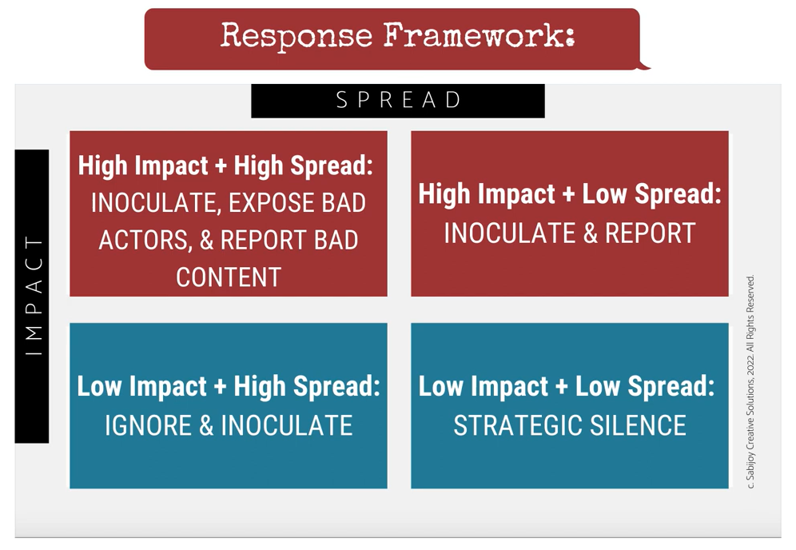
Activity: How to respond? Use the framework below to guide your decisions.
Notes:
PRESENTERS: In this activity, you’ll share three different scenarios of disinformation, present your audience with three different options for response, then discuss the appropriate response for each scenario based on the response framework.

Slide 24
Activity: Scenario 1
You see a tweet (12 likes, no RTs) from an unverified account with 707 followers that shares the wrong date and location for an upcoming local election.

Slide 25
Activity: Scenario 1
Do you…..
Alert your community by sharing and debunking it so they know it and the sender are bogus?
Send out a new tweet with the correct information?
Report it to Twitter/X?

Slide 26
Activity: Scenario 1 Response
Don’t amplify! CLARIFY.
Notes:
This is a high impact – low spread scenario. This incorrect information can have significant consequences for peoples’ opportunity to vote but is not being widely spread.
Recommended response: Don’t repeat the misinformation or spread it any further. Instead, clarify by sharing the right information on your feed or with your networks, without sharing the misinformation.

Slide 27
Activity: Scenario 2
Students at a state university receive text messages that because of high anticipated voter turnout, polling locations on campus will also be open on Wednesday, the day after Election Day, and students are urged to wait a day to cast their ballot.
Notes:
PRESENTER: Read the scenario​ and then present the three response options in the following slide.

Slide 28
Activity: Scenario 2
Do you…..
Post a screenshot of the text message on social media to warn and alert others about the disinformation?
Report it to the authorities?
Amplify the correct and factual information and point to recommended and trusted sources of information?

Slide 29
Activity: Scenario 2 Response
Inoculate, report, hold bad actors to account.
Notes:
This is a high impact – high spread scenario. This incorrect information can have significant consequences for peoples’ opportunity to vote and is being widely spread.
First, don’t repeat the disinformation by taking screenshots and sharing them or highlighting the disinformation in any other ways!
Second, report this behavior to the relevant authorities where you are, whether it’s campus administration and/or law enforcement
Third, clarify by sharing the right information on your feed or with your networks, without sharing the misinformation.

Slide 30
Activity: Scenario 3
A well-known celebrity posts a widely viewed Instagram reel falsely claiming that “woke” universities are secretly tracking individual student voting behavior and keeping a record of those who vote the “wrong” way. Students should protect their privacy by not voting!

Slide 31
Activity: Scenario 3
Do you…..
Share the Instagram reel and mock the celebrity for their ignorance with hilarious snark?
Add a comment on social media to the post in question, correcting the false information and pointing to credible sources?
In a separate post, name some of the bad actor(s) behind such statements and point to more credible sources of information?

Slide 32
Activity: Scenario 3 Response
DO NOT share the post. DO highlight and share credible sources of information that correct the false information, potentially by commenting on the post directly.
Notes:
This is definitely another high impact – high spread scenario.
While it’s important to not share the post and to highlight and share credible sources of information instead, in this particular case the individual spreading the disinformation may be doing it unwittingly, influenced by other bad actors—especially anti-democratic forces—who have intentionally pushed this type of disinformation.
In instances like this, when a specific disinformation narrative is gaining widespread traction—and especially when you see it creeping into mainstream media and public discourse—you may need to directly address the specific disinformation itself. While the bar should be high for this (remember that you want to avoid amplifying disinformation if possible) there is a specific recommended approach for doing so—a technique known as a “truth sandwich.”
With this approach you lead first with the correct and accurate information you are trying to convey, not with the disinformation. You then follow that with a brief reference to the disinformation you are countering—and explicitly indicate that the claim being made is false. Name the bad actors behind it if possible as well. Lastly, close by repeating the correct and accurate information again, including recommended resources and trusted sources of information about the topic.
One last thing: When you are communicating the correct information and facts, do not do so by repeating the disinformation with a negation, such as ”Universities are NOT tracking individual student voting behavior.” Research shows people are more likely to remember the point of disinformation—“Universities are tracking individual student voting behavior.”—than the negation of it.

Slide 33
Common pitfalls to avoid

Slide 35
Key takeaways: Common pitfalls to avoid
Pitfall 1: Centering facts over storytelling
Pitfall 2: Focusing on doom and gloom stories
Pitfall 3: Myth-busting and being reactive
Pitfall 4: Manipulating audiences through fear and anger
Pitfall 5: Using the passive voice
Pitfall 6: Overestimating opposition, underestimating our power

Slide 36
Discussion: Common pitfalls to avoid
Consider the following questions:
Have you encountered or dealt with one of the common pitfalls of responding to disinformation?
If possible, think of a specific example. How might a response have been done differently?
Notes:
PRESENTERS: Break up your audience into groups of three or four to discuss.

Slide 37
Addressing common pitfalls

Slide 38
Notes:
Background, context, and supporting science and research for reference.
From Sabrina Joy Stevens:
Why I focus on storytelling:
I believe in – and teach – the power of story and metaphor because people have relied on storytelling to share knowledge and build culture for thousands of years. A robust, diverse body of research across multiple psychological disciplines supports this approach, affirming that:
Story is central to how people think and learn.
Alison Gopnik, Andrew N. Meltzoff, & Patricia K. Kuhl (1999). The Scientist in the Crib: Minds, Brains, and How Children Learn. HarperCollins Publishers, New York, NY.
National Research Council (2000). How People Learn: Brain, Mind, Experience, and School (Expanded Ed.). The National Academies Press, Washington, DC.
Jonathan Gottschall (2012). The Storytelling Animal: How Stories Make Us Human. Houghton Mifflin Harcourt, Boston, MA.
Metaphor plays a critical role in reasoning processes.
George Lakoff & Mark Johnson (1980, 2003). Metaphors We Live By. University of Chicago Press, Chicago, IL.
Paul H. Thibodeau, Lera Boroditsky (2011). “Metaphors We Think With: The Role of Metaphor in Reasoning.” PLoS ONE 6(2): e16782
Storytelling helps audiences better understand issues of public concern.
Brandi S. Morris, Polymeros Chrysochou, Jacob Dalgaard Christensen, Jacob L. Orquin, Jorge Barraza, Paul J. Zak & Panagiotis Mitkidis (2019). “Stories vs. facts: triggering emotion and action-taking on climate change.” Climatic Change, 154, 19-36

Slide 39
Key takeaways: Techniques for addressing common pitfalls
Instead of... Centering facts over storytelling --> Use stories to illuminate collective trends. Facts are important but not enough!
Instead of... Focusing on doom and gloom stories --> Name what is but focus on what is possible. ​
Instead of... Myth-busting and being reactive --> Use news cycles and real-world incidents to advance your fact-based narratives and overarching goals.​​

Slide 40
Key takeaways: Techniques for addressing common pitfalls
Instead of... Manipulating audiences through fear and anger --> Meet people where they are and lead them to somewhere better.​
Instead of... Using the passive voice --> Name actors and systemic dynamics. ​ ​
Instead of... Overestimating opposition, underestimating our power --> Speak from a position of power.​ ​​

Slide 41
Example: Addressing pitfalls
After it was announced that registered voters in Michigan would receive applications for absentee ballots in the mail, “Trump took to Twitter to claim that the move was done ‘illegally’… Trump later threatened to suspend federal funding to Nevada, which is holding a mail-in primary election, claiming it would create a ‘great Voter Fraud scenario’ and allow people to ‘cheat in elections,’” the Hill reports.
Replace this…
With
this…
On Wednesday, President Trump attacked states like Michigan and Nevada for protecting voters’ from COVID-19 in upcoming elections by sending applications for absentee ballots.
Notes:
To highlight some of the common pitfalls you may see, and to highlight an example of how to address these common pitfalls, let’s look at an example that Sabrina references in one of the video clips.
I’m going to read a written description of a piece of disinformation, and then read a example of how to respond to the disinformation without repeating or amplifying it.
After it was announced that registered voters in Michigan would receive applications for absentee ballots in the mail, “Trump took to Twitter to claim that the move was done ‘illegally’… Trump later threatened to suspend federal funding to Nevada, which is holding a mail-in primary election, claiming it would create a ‘great Voter Fraud scenario’ and allow people to ‘cheat in elections,’” the Hill reports.
And here’s how this was replaced in the example…
On Wednesday, President Trump attacked states like Michigan and Nevada for protecting voters’ from COVID-19 in upcoming elections by sending applications for absentee ballots.
Please note how the same message was provided without repeating or elevating Trump’s lies or the tweets where they surfaced.

Slide 42
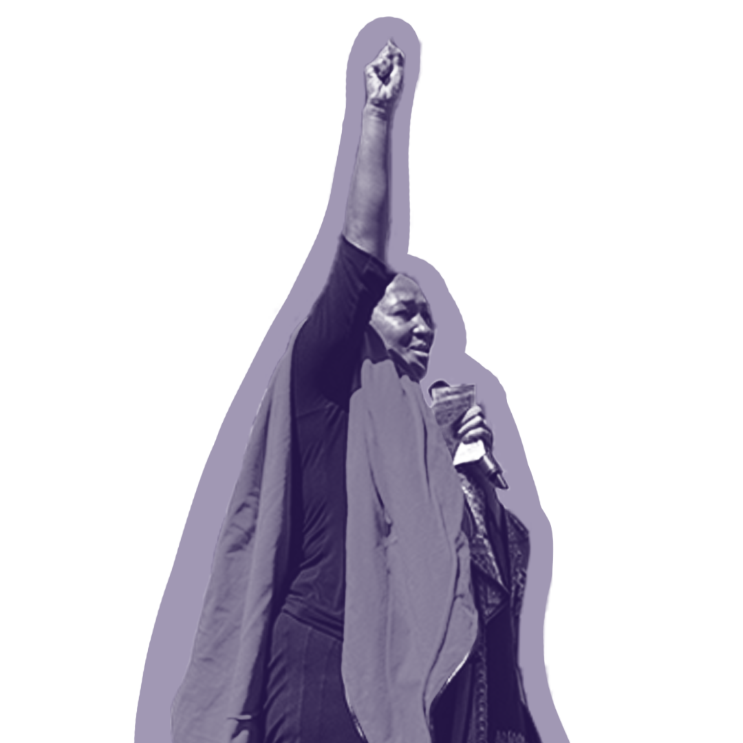
Discussion: Addressing common pitfalls
Think of an example you’ve seen or done that responded to a specific instance of disinformation, or reuse your example from the previous section.
Did it fall into a common pitfall?
How could it have been done differently?
Notes:
PRESENTERS: Discuss as a group or break into smaller groups to discuss.

Slide 43
Building Your Narrative

Slide 44
Notes:
Background, context, and supporting science and research for reference.
From Sabrina Joy Stevens:
My Three As: Accurate, Aspirational, Actionable
After years of observing recurring patterns in both empirically-based messaging frameworks and communications developed within highly-influential real-world campaigns, I coined the “Three As” (accurate, aspirational, actionable) to make it easier for clients and training participants to remember and implement in their own communications, particularly in the absence of time and resources for polling or message testing. Some examples of messaging frameworks and campaigns that exemplify the effectiveness of accurate, aspirational, and actionable messaging and storytelling include:
The Race Class Narrative developed by Heather McGhee, Anat Shenker-Osorio, Ian Haney López, Lake Research Partners, Brilliant Corners, SEIU, and Dēmos
The (United States-based and international) campaigns profiled in Words to Win By, hosted by cognitive linguist and political communications expert Anat Shenker-Osorio
Other influential campaigns, including but not limited to:
The Chicago Teachers’ Union’s 2012 report and related campaign “The Schools Chicago’s Students Deserve: Research-based Proposals to Strengthen Elementary and Secondary Education in the Chicago Public Schools” and its 2018 update
The latter years of the decades-long campaign for marriage equality in the United States
The national Red for Ed Movement/strike wave (2018-2019) (Click here for example messaging, adapted by the California Teachers Association.)

Slide 45
Key takeaways: Building your narrative
Accurate, Aspirational, Actionable: The three A’s for content narratives that inoculate against disinformation
An accurate message reflects truth as validated by experience and rigorous research.
An aspirational message offers an attractive possible future that inspires audiences to answer your calls to action.
An actionable message offers clear, practical next steps that people can take to move us closer to our desired future.
Replace, don’t repeat: Avoid amplifying the disinformation spread by bad actors whenever possible. Replace it with accurate, aspirational, and actionable content instead.

Slide 46
Activity: Build a Narrative
Develop and outline a narrative using the communications techniques you’ve learned—including the three A’s (accurate, aspirational, actionable)—to counter a specific point of disinformation of your choosing.
Some possibilities to consider:
Vaccines are dangerous
It’s too late to do anything about climate change
Your vote doesn’t matter
Notes:
Take 5 minutes individually to develop a narrative that addresses but does not repeat a common point of disinformation, then spend 5 minutes sharing with the group.
Remember the 3 As: accurate, aspirational, and actionable
And Replace, don’t Repeat!

Slide 47
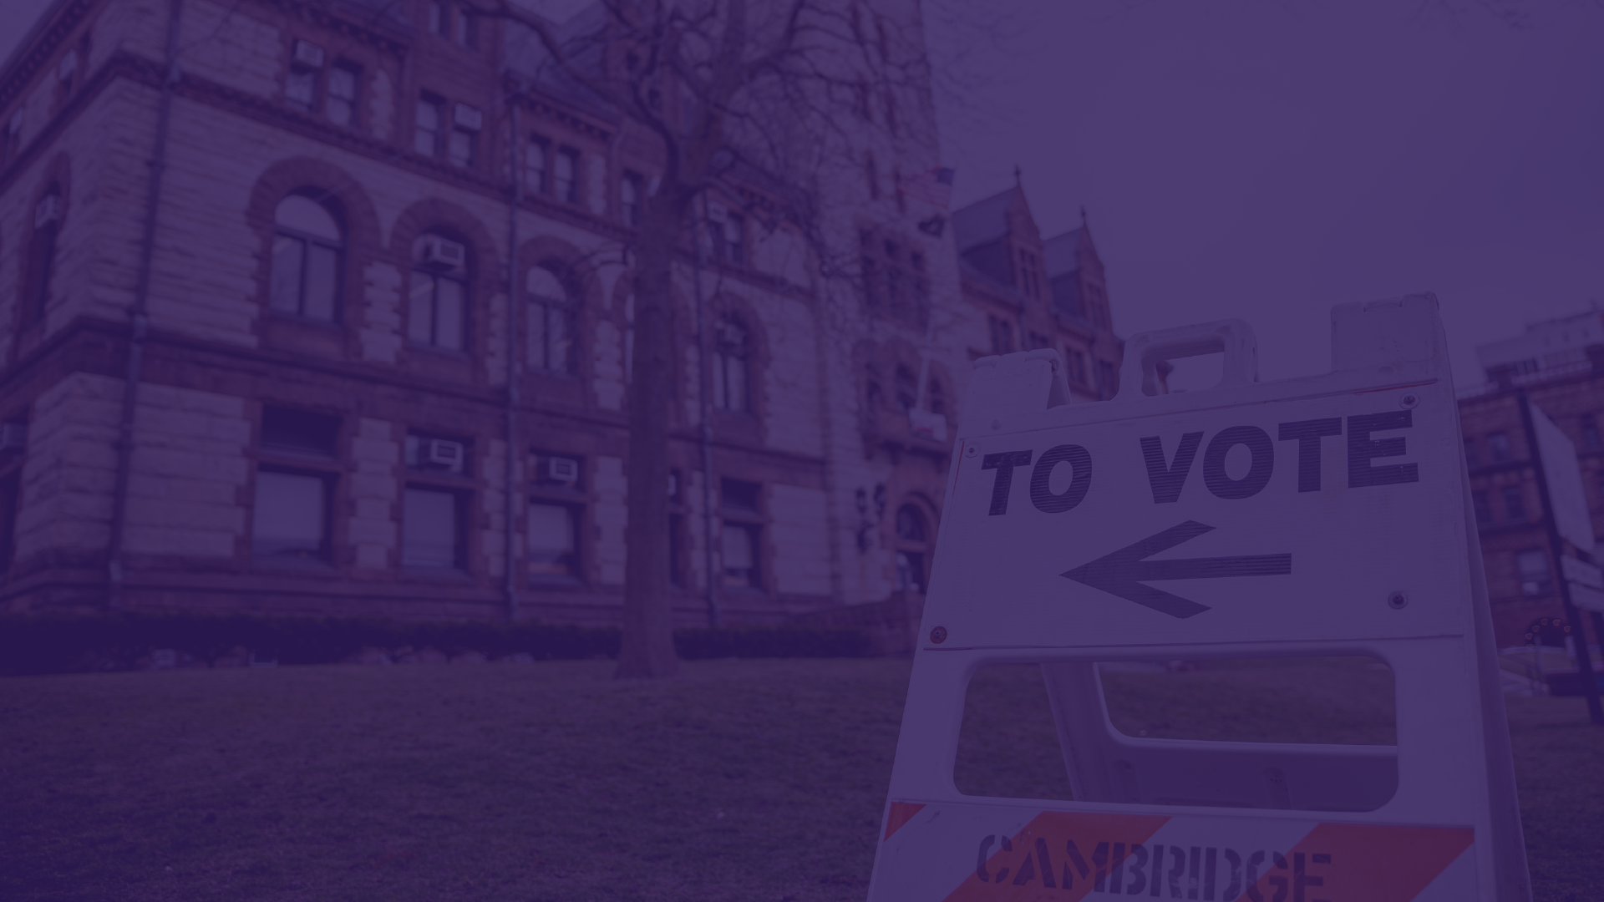
Voter suppression and disinformation

Slide 48
Voter Suppression and Disinformation
As elections approach, expect to see bad actors using disinformation to suppress voter participation and turnout.
Bad actors often specifically target Black, Indigenous, and other communities of color to keep them away from the polls.
A related tactic is to intim­id­ate voters with false reports of law enforce­ment pres­ence, immig­ra­tion enforce­ment actions, or elec­tion monit­or­ing by armed indi­vidu­als.
Legal remedies exist, but are often too late.
Notes:
In the run up to this year’s elections, bad actors will almost certainly use disinformation in an effort to suppress voter participation and turnout.
In the United States, there is a long history of bad actors using decept­ive prac­tices to spread false inform­a­tion in an attempt to trick people out of voting, particularly to keep Black, Indigenous, and other communities of color or marginalized communities away from the polls. And in recent years, the inter­net and social media plat­forms have increased the threat of vote suppres­sion. During the pandemic, voters have been more depend­ent on online inform­a­tion. As a result, the risk for voter disen­fran­chise­ment due to disin­form­a­tion continues to grow.
There is a multi­tude of stor­ies about attempts to trick certain people out of voting. These decept­ive prac­tices have often involved the use of flyers, mail­ers, and robocalls. In 2004, flyers distrib­uted in Frank­lin County, Ohio, falsely told voters that Repub­lic­ans should vote on Tues­day and Demo­crats on Wednes­day due to high levels of voter regis­tra­tion. A related tactic is to intim­id­ate voters with false reports of law enforce­ment pres­ence, immig­ra­tion enforce­ment actions, or elec­tion monit­or­ing by armed indi­vidu­als. These voter suppres­sion tactics frequently target histor­ic­ally disen­fran­chised communit­ies, includ­ing communit­ies of color, low-income communit­ies, and immig­rant communit­ies. For example, on Elec­tion Day in 2010, Mary­land gubernat­orial candid­ate Bob Ehrlich’s campaign manager targeted African Amer­ican house­holds with robocalls claim­ing that Governor Martin O’Mal­ley had already been reelec­ted, imply­ing that his support­ers could stay home instead of voting.
Resource:
https://www.brennancenter.org/our-work/research-reports/digital-disinformation-and-vote-suppression

Slide 49
What are the Consequences of Voter Suppression?
Worse public health and safety outcomes, weaker environmental protections, and racist and inequitable policies.
Notes:
What does voter suppression have to do with science? The evidence shows that public health and safety outcomes are worse in communities where voter suppression has occurred, and voters are systematically excluded from the process. Environmental protections are weaker or non-existent and environmental justice is not achieved.
Over the last decade, public health has become increasingly tied to the health of our democracy. Life expectancy has been declining for the first time in nearly a century. At the same time, many state legislatures have insulated themselves from public accountability through extreme partisan gerrymandering and restrictive election laws. Biased, unrepresentative state legislatures have been less likely to expand access to health care, and health disparities in those states have continued to worsen, especially for communities already under greater social distress. The United States needs to restore and improve electoral integrity and political equality in state legislatures to address growing inequalities and empower communities to protect themselves.
Restrictive election laws distort representation to favor entrenched, powerful interests. This has not only weakened environmental regulations (possibly leading to poorer air quality in many communities) but also weakened the ability of citizens in these communities to preserve or enact local environmental protections. Overall, congressional districts in gerrymandered states exhibit poorer air quality, consistent with the notion that these legislatures are less responsive to communities that suffer the burdens of unregulated environmental degradation. Systemic racism pervades almost all that the government does when voters are suppressed – because elected officials do not have to address the needs of these communities to maintain their power.
Resources:
https://blog.ucsusa.org/andrew-rosenberg/scientists-get-involved-in-democracy-reform
https://www.ucsusa.org/sites/default/files/2019-10/ucs-es-voting-10-19-web.pdf
https://www.ucsusa.org/sites/default/files/attach/2018/09/building-a-healthier-democracy-report.pdf

Slide 50
Voter Suppression and Disinformation: What You Can Do About It
Watch for voter suppression tactics—and respond using the communications techniques you’ve learned today.
Use trusted sources to verify
Report disinformation to Election Protection: 866-OUR-VOTE.
Notes:
Don’t despair: There’s a lot you can do to protect your networks and community against disinformation and voter suppression tactics.
Now that you know about how to avoid common pitfalls and develop effective narratives in response to disinformation, watch for voter suppression tactics like spreading disinformation about voting and the election as the elections draw closer. And make sure you follow best practices when you are crafting your response!
If you have questions about election-related information, or think you see voter suppression tactics, confirm the correct information through trusted sources like the Brennan Center for Justice, your Secretary of State’s website, or for students, Campus Vote Project.
If you do confirm that it is disinformation, and it is being spread on a wide scale, report it to Election Protection. Elec­tion Protec­tion is a national nonpar­tisan coali­tion that main­tains rela­tion­ships with elec­tion offi­cials across the coun­try. You can visit their website or call 866.OUR.VOTE. Elec­tion protec­tion volun­teers will record incid­ents, look for patterns, and help pass inform­a­tion to inter­net compan­ies, offi­cials, and ulti­mately affected communit­ies and indi­vidu­als.
Resource: https://www.brennancenter.org/our-work/analysis-opinion/voters-vs-disinformation

Slide 51
Questions?

Slide 52
Take Action!
Reflect:
What did you take away from this training? Write down your plan of action.
Notes:
PRESENTERS: Have participants take 5 minutes to reflect and start writing down their action plans.
​

Slide 53
Attribution
Sabrina Joy Stevens, communications strategist and trainer​
Also credit to Jane McAlevey’s “Strike School,” based on her book No Shortcuts: Organizing for Power in the New Gilded Age. ​
​
Notes:
This training is adapted from the intellectual property of communications strategist Sabrina Joy Stevens. Credit also goes to Jane McAlevey’s “Strike School,” based on her book No Shortcuts: Organizing for Power in the New Gilded Age. ​
​
For more resources like this, visit ​https://ucsusa.org/resources/how-stop-disinformation​

Slide 54
For Trainers: Additional Photos/Stickers
The following slides contain assets that are available to fill in where appropriate
Hide these slides before presenting

Slide 55
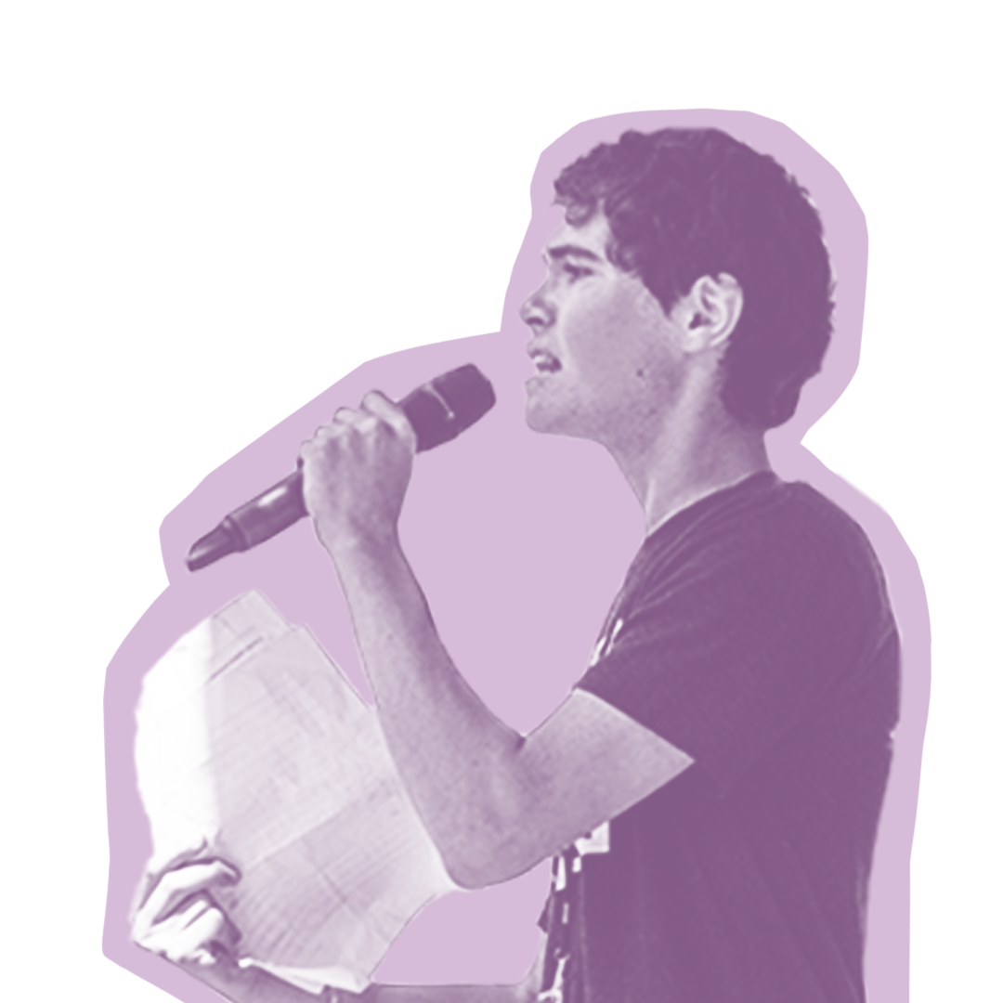
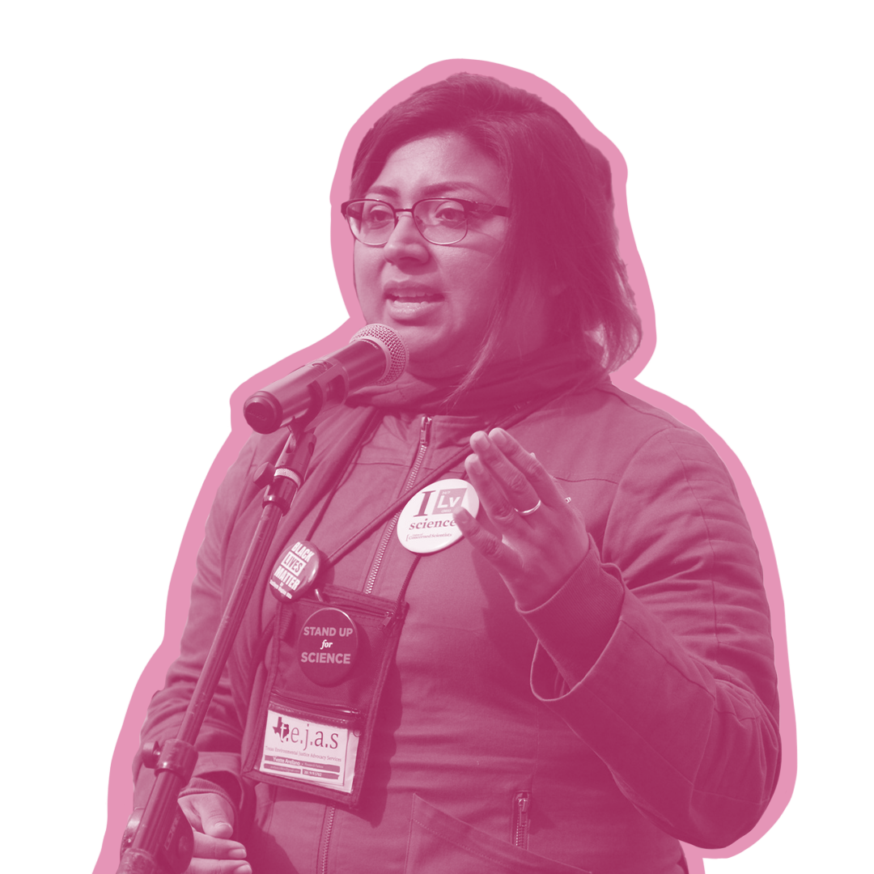
Stickers: Speakers

Slide 56
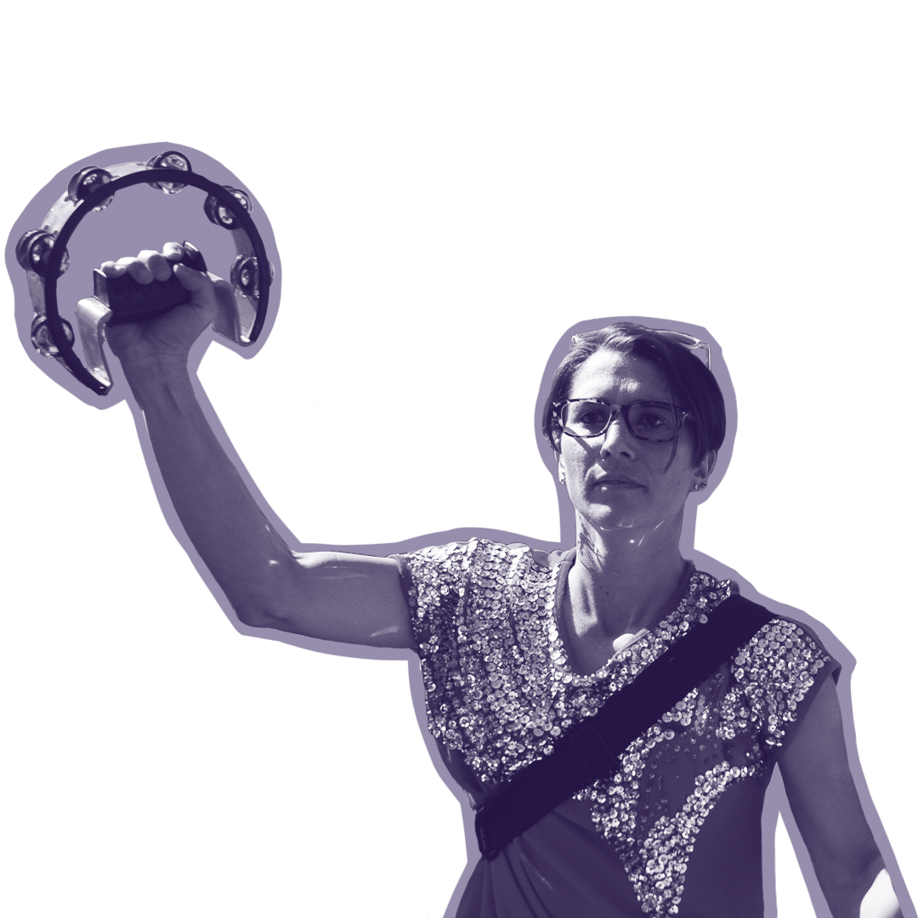
Stickers: Demonstrating/Signs

Slide 57
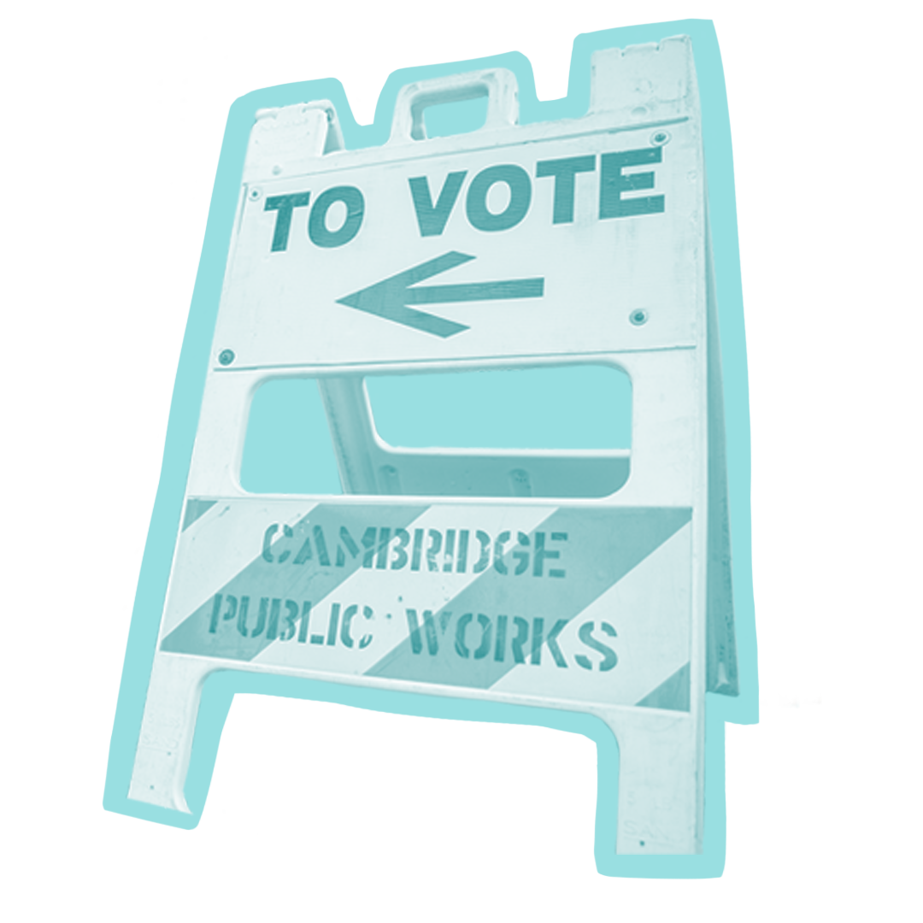
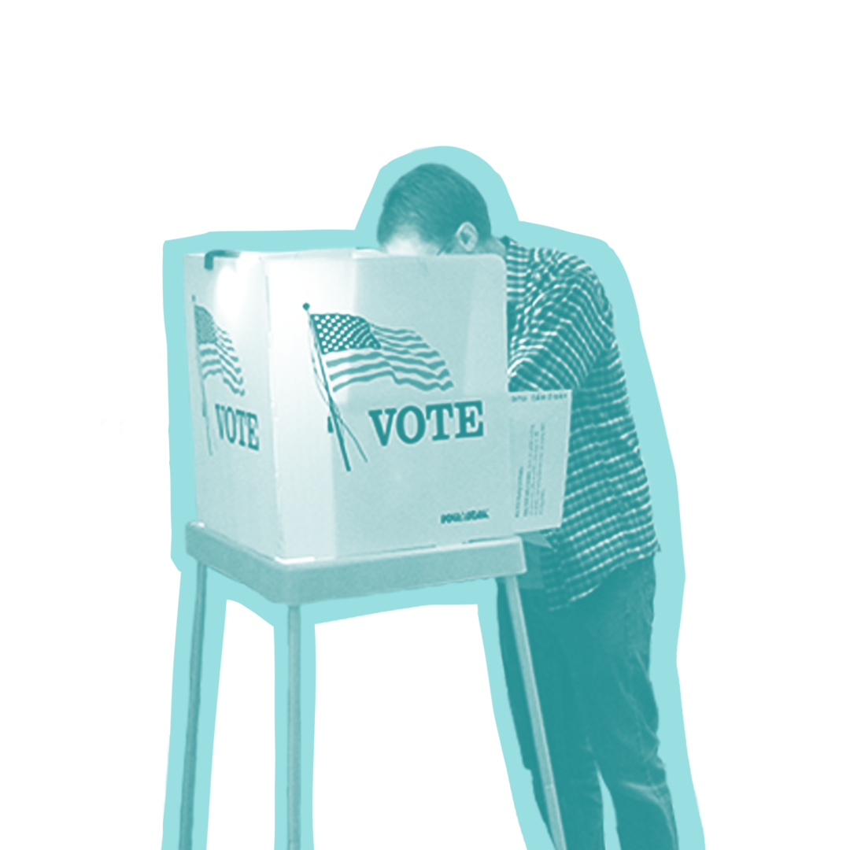
Stickers: Voting/Registration

Slide 61
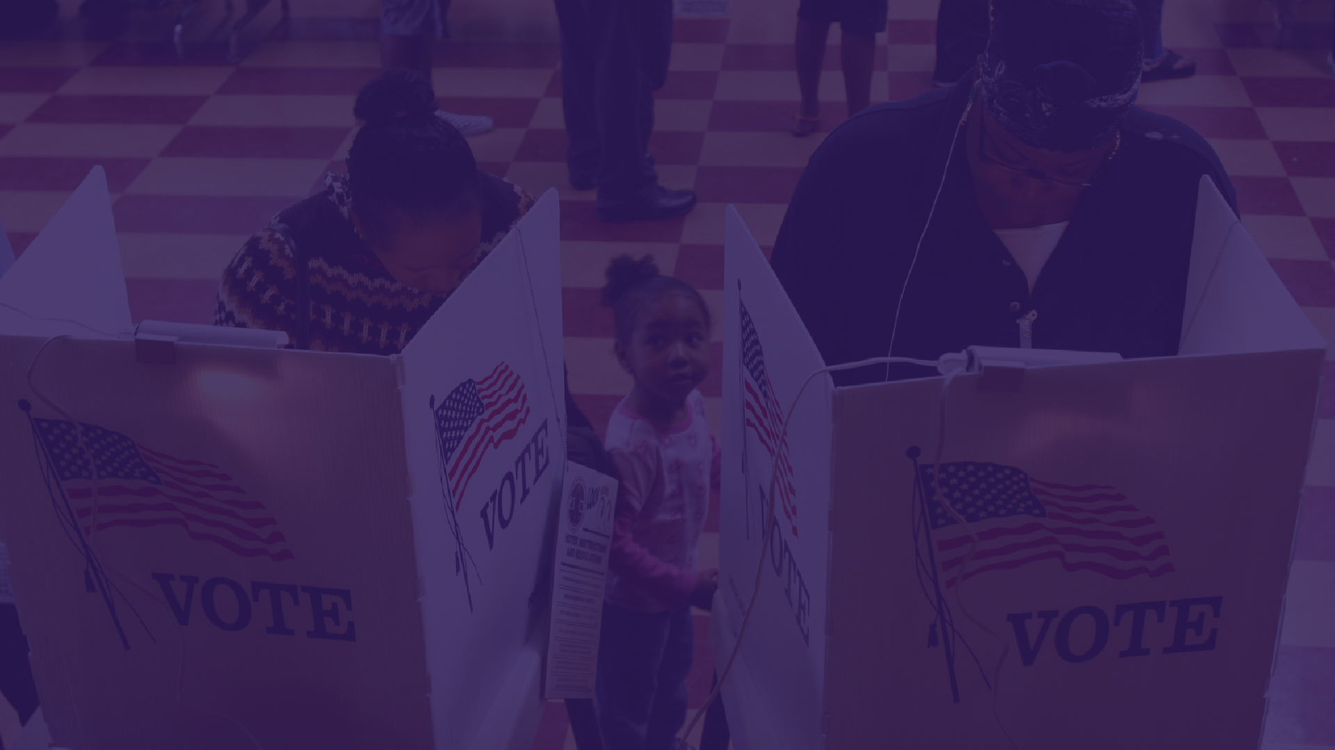

Slide 62
