Slide 1
Student Voter Registration and Mobilization
Notes:
Hi and welcome!
Check all the zoom settings, can everyone see and hear you?

Slide 2
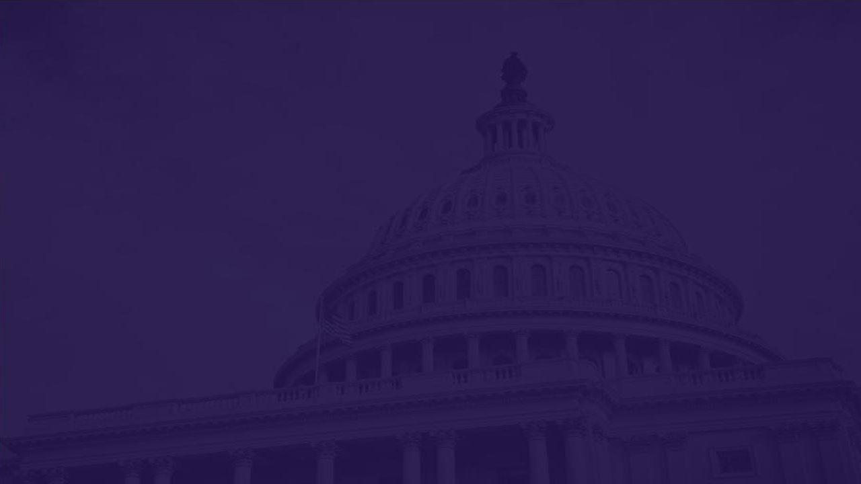
What this training covers
Science and Democracy
How to Register to Vote
Voter Mobilization
Voter Suppression and Disinformation
Notes:
TRAINERS: Customize your agenda to your audience and the amount of time you have. This presentation covers all of the above listed topics and is designed to be completed in one hour.

Slide 3
Customize Your Agenda
Science and Democracy
How to Register to Vote
Voter Mobilization
Voter Suppression and Disinformation
Notes:
MELISSA Remember to customize your agenda!

Slide 4
Scientists and Democracy
GOOD NEWS! Scientists and the scientific community are participating in our democracy at record levels.
Notes:
Let’s start with some good news: STEM students are turning out to vote at higher rates than ever before, and scientists are getting involved in our democracy to stand up for equitable solutions that benefit ALL of us.

Slide 5
Voting Rates by Field of Study
STEM voter turnout increased dramatically in 2020
But STEM voters still lag behind the average student turnout
+16% +11% +13% +15% +14% +11%
2020
Average
Turnout
66%
Notes:
In 2020, voter turnout hit record levels. Student voter turnout also increased dramatically in 2020 over 2016, reaching 66% in 2020. ​
Thanks to the National Study of Learning, Voting, and Engagement, out of Tufts University, we have student voter turnout breakdowns by fields of study. Some of you may have heard that STEM students have the lowest voter turnout rates of any field of study. Well, I am pleased to share that we saw double-digit increases in voter turnout across all STEM fields in 2020.
CLICK
You may also notice that some of these fields are still lagging behind the average student turnout rate of 66%. We certainly still have work to do increasing voter engagement among STEM students—and that’s why we’re here today.
Resource: https://idhe.tufts.edu/nslve/2020

Slide 6
Democracy Needs Science
Scientists should advocate for using science to solve societal challenges such as climate change, COVID-19, racial and economic injustice.
Scientists can contribute by:
Communicating with the public and decision makers
Making information accessible
Building support for science-based decisions
Notes:
Increasing STEM student voter registration, turnout, and broader civic engagement is critical because the health of our democracy quite literally depends on scientists being active participants. We have seen the deadly consequences of ignoring or distorting scientific recommendations with increasing climate-related disasters. Scientists (including future scientists and STEM students) can contribute to our democracy by 1) effectively communicating their expertise to their communities, decision makers, and the media, 2) providing the public with access to reliable scientific information, and 3) building support for science-based decisions by working with local groups to show how science-based policies can benefit all of us.
Resource: https://blog.ucsusa.org/michael-latner/the-shared-fate-of-science-and-democracy/

Slide 7
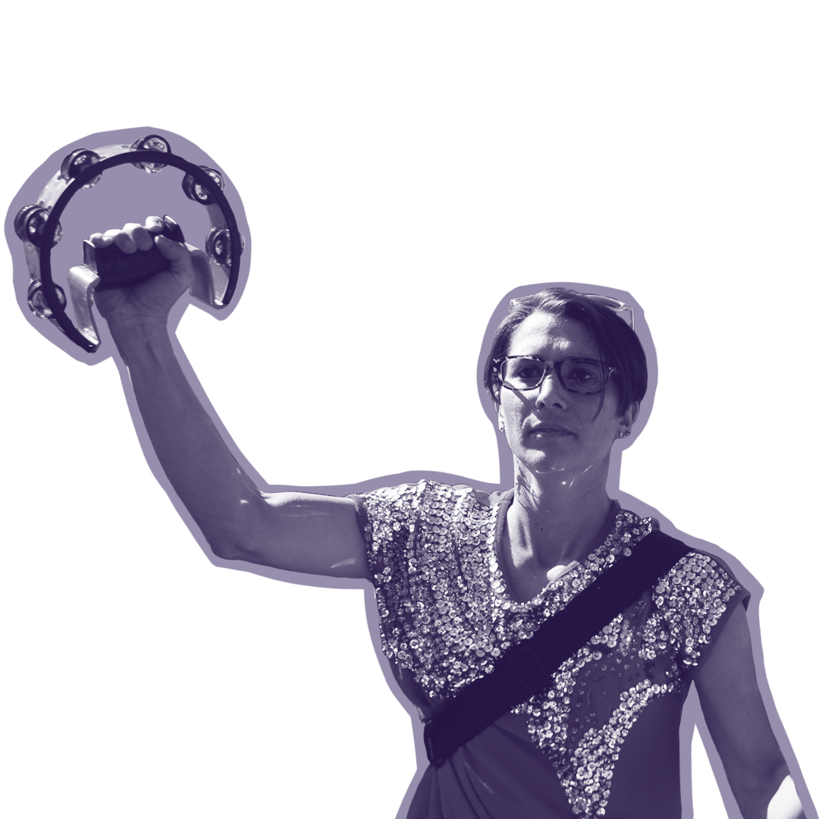
You Are More Than Your Field of Study
What other issues are you passionate about?
What issues impact your family and friends?
What does your vision for a better future look like?
Notes:
MELISSA: Even though we’re here today as part of the scientific community, remember that being a STEM student is just one aspect of your identity. You are more than your major or field. Speaking out on issues outside your discipline and expressing your values does not mean that your “objectivity” or the rigor of your research is compromised. We are all more than our majors and our day-to-day work. We are members of society, our communities, and constituents in this democracy. We have other muscles to flex.
Don’t think that today’s challenges are someone else’s to worry about.
Don’t think that publishing academic papers and conducting research is all you have to contribute.
Don’t hold yourself apart from the public and remain silent on public policy.
Don’t think that voting and being civically engaged somehow diminishes your training, talent, passion, or creativity.
You have the freedom (and some would say the duty and responsibility) to engage in our democracy—and it doesn’t have to solely be related to science issues.
What other issues are you passionate about?
What issues impact your family and friends?
What drives you? What does your vision for a better future look like? What steps can we take to get there?
Resource:
https://blog.ucsusa.org/kathleen-rest/lessons-from-a-career-serving-the-public/

Slide 8
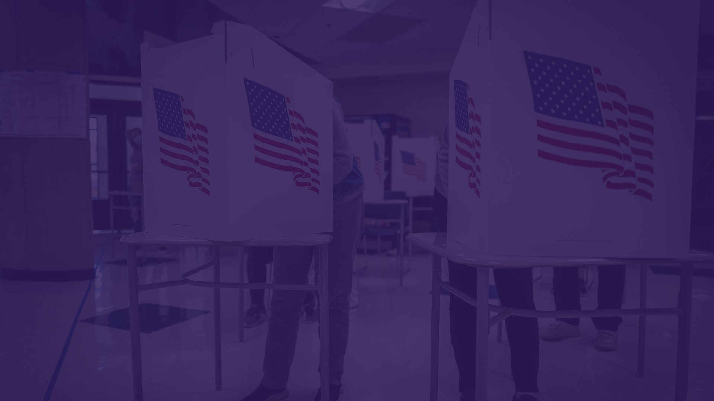
How to Register to Vote
Notes:
One step (but not the ONLY step) you can take is voting. Let’s talk about some frequently asked questions about voting.

Slide 9
Voter Registration Basics
4 reasons why you need to register (or re-register) to vote.
1. You have never registered before.
2. You have moved.
3. You’ve changed your name.
4. You’ve changed political parties. **
Notes:
Can anyone guess one of the 4 reasons you’d need to register or re-register to vote?
1. You have never registered before.
2. You have moved. If you have a new residence, you need to update your voter registration or re-register. If you‘re a student, you may be considering registering where you go to school—learn about the laws that affect students in your state through a trusted resource, like the student guides at the Campus Vote Project.
3. You’ve changed your name. If you’ve legally changed your name, you’ll need to re-register.
4. You’ve changed political parties. If you’re planning on voting in a primary, your state may require you to choose a party affiliation in order to vote in that party’s primary. Some states don’t allow those who are registered as independents to vote in either primary, so be sure to check!
In order to vote, you must be a citizen who is eighteen years or older. If you have lost your right to vote due to felony convictions, the ACLU has state by state information about felony disenfranchisement laws, and you can visit your Secretary of State’s website to learn how to get your voting rights restored.
When registering, have either your driver’s license or state ID number ready. If you don’t have either of those for the state you’re registering in, the last four digits of your social security number is usually sufficient.
Resources: https://www.campusvoteproject.org/state-student-voting-guides.
https://www.aclu.org/issues/voting-rights/voter-restoration/felony-disenfranchisement-laws-map

Slide 10
Voter registration laws and deadlines vary from state to state
Use a trusted resource to help you register, check your registration, and sign up for election-related reminders.
Notes:
The US has a decentralized election system—that means elections are run by counties or cities, and election laws can vary from state to state. That’s why different states have different voter ID laws, and different laws about mail-in ballots, early voting, and so on. There are pros and cons to the way this system is set up, but it does make it difficult to keep track of all of the rules across the country. That’s why it’s imperative you use trusted resources to find election information. One tool (though there are many others) you can use to register to vote, check your registration, and sign-up for election-related reminder is TurboVote, at TurboVote.org, which is a nonpartisan nonprofit that makes it easier for people to participate in elections.

Slide 11
Voter Registration FAQ
I’m a student and I’m not sure where to register. What should I do?
Notes:
There are a number of different scenarios for where students should register to vote. As always, you should refer to a trusted resource to learn more about the rules in your state. The Campus Vote Project has a map specifically geared towards helping students figure out where to register.
Remember that you can only be registered to vote in ONE state. Be aware that where you are registered to vote has implications for the type of identification you’ll need on Election Day and may affect whether you need to change your driver’s license and vehicle registration. It should not affect federal financial aid or your school tuition status.
Resource: https://www.campusvoteproject.org/state-student-voting-guides

Slide 12
Voter Registration in [YOUR STATE]
Voter registration deadline: [Date]
Upcoming elections
Primary election voter registration deadline: [Date]
Primary/ies: [Date]
Special election voter registration deadline: [Date]
Special election/s: [Date]
General election voter registration deadline: [Date]
General election: [Date]
[STATE]’s official election website: [URL]
ID required to register: [Yes or No]
ID required to vote: [Yes or No]
How to vote options: [by mail with/without an excuse, early in-person, election day]
Notes:
**Presenters: fill out this slide using Campus Vote Project Resources: https://www.campusvoteproject.org/state-student-voting-guides
Only include the information relevant to your audience (if the primaries have passed by the time you give your training, no need to include them!)

Slide 13
Activity: Register to Vote or Check Your Registration
Visit Turbovote.org
Register to vote*
Check your registration
Sign up for election reminders
Notes:
**presenters, if you are in a state that doesn’t allow online registration, be prepared to talk through how participants can still use this tool to pre-fill their registration form before they print it out. If you are giving an in-person training, consider having a printer on-site or nearby where people can print and mail their forms.
TurboVote is a tool designed to help voters with the voting process. It tracks elections at all levels, local through national. TurboVote keeps track of voter registration, absentee, and vote-by-mail rules for all 50 states and Washington, D.C. TurboVote is a product of Democracy Works, a nonpartisan, nonprofit 501(c)(3) organization that works to modernize the voting process and increase voter accessibility. Visit https://turbovote.org/ right now to check it out. It can help by:
Guiding you through the voter registration process;
Helping you start the absentee or mail-in ballot request process;
Sending you text and email reminders about upcoming elections; and
Supporting you through the entire voting process, with a fully staffed user support team
Resources:
https://www.democracy.works/turbovote-about
https://turbovote.org/

Slide 14
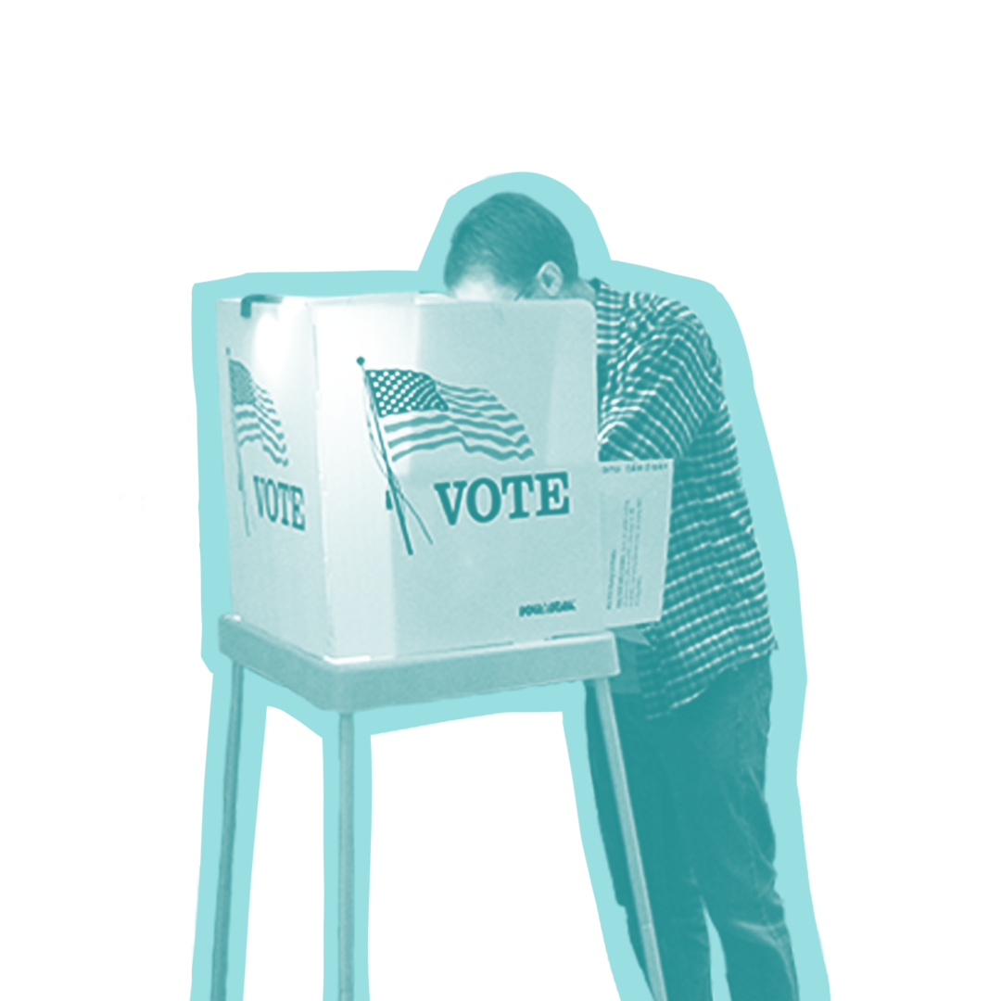
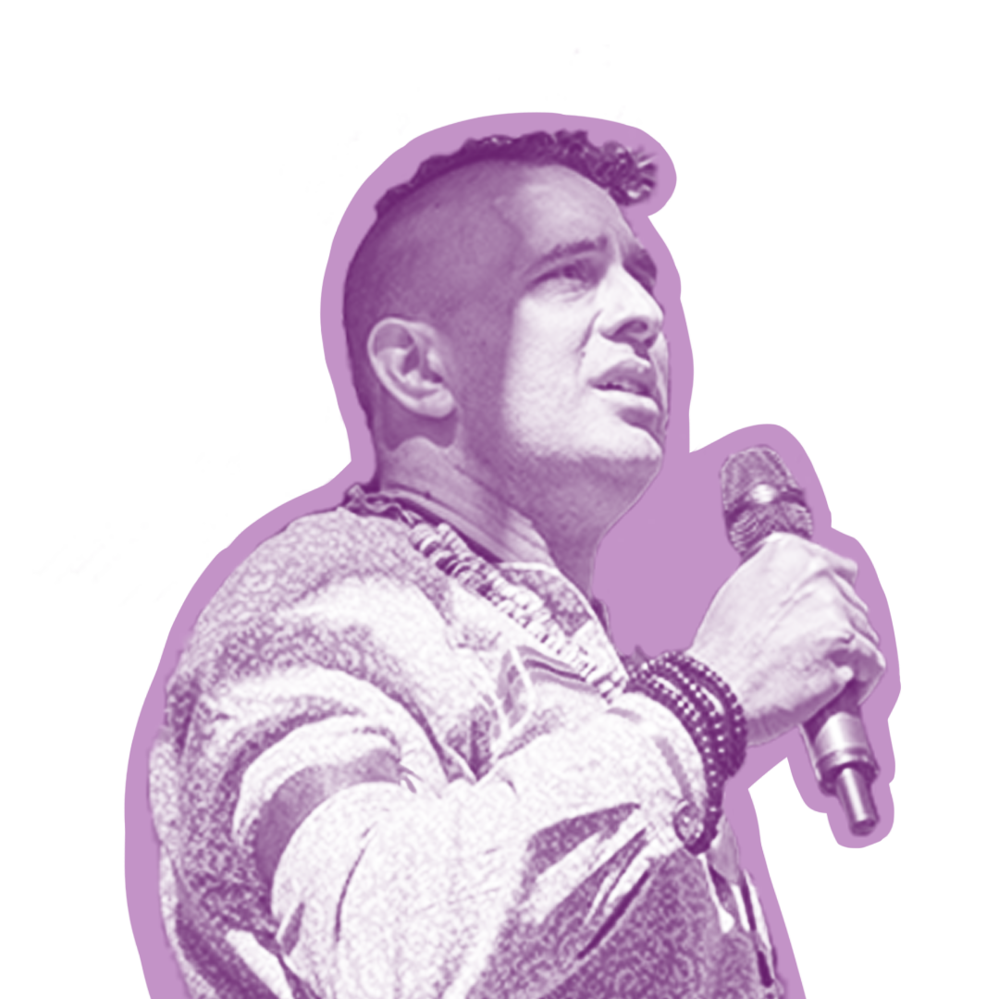
STEM Is on the Ballot
Ballot Initiatives
Candidates
Notes:
Okay—you’re registered, there’s an election coming up—now what?
When you’re looking at your ballot, or using a site like BallotReady to do research, there are a few ways that STEM issues may show up:
For ballot initiatives, referenda, and propositions:
What is being proposed?
Who could benefit from the proposal, and who could suffer from it? (Think especially about how some neighborhoods or groups in your area may already be dealing with system issues or not getting the support they need—will this proposal help or hurt them?)
Finally, of course, how will the proposal affect me?
For candidates 1. What are the responsibilities of the office?
2. Who is running?
3. How does the candidate propose to care for their constituents during their time in this office? (Look especially for how they will address the problems facing neighborhoods who need more support, or have systemically been under-resourced).
Also consider: do candidates’ values align with yours? How do they talk about science in their messaging and their platform?
Resource: https://www.votingstudyparty.org/hosting.html

Slide 15
STEM Is On the Ballot
Engineering → roads, bridges, dams
Geology → mining impacts, environmental justice
Economics → cryptocurrency, student loans
Computer science → cybersecurity, AI
Plus: how do health and equity issues impact your ability to do research?
Notes:
As you’re looking at the ballot initiatives, and candidates and their stances on issues, think about how different disciplines connect with voting and our democracy.
You can find more of these examples in the Science and Civics Guide. https://docs.google.com/document/d/1srQwMsGn35dw8D7E1I5En-mc_FJGBFFr5JmBhzcp0JM/edit
These are just a few areas where science, voting, and policy intersect. What’s missing? How do issues related to your discipline connect to voting?
Once you’re registered and informed, it’s time to VOTE—and also get others to turn out to vote! (turn it over to Matt)
****
What local infrastructure issues have you noticed? Crumbling bridges, wider highways, safer bike paths? Engineering can help design solutions to these problems—and should help us think through the trade-offs of these choices.
Many people do not realize how geology relates to environmental science and subsequently environmental justice. Geology goes into the site evaluation process for new buildings, which is another way that geology informs policy, and therefore relates to voting.
Outside of these specific fields, it's also worth thinking about how public health and equity issues impact people's ability to show up and do research and study. For example, think about how extreme weather events like heat waves or hurricanes inhibit the ability for data to be collected during crucial times of the field season or make it unsafe for researchers and field technicians who are working primarily outside.
Resource: https://docs.google.com/document/d/1tuvT_YT2ecJfZnQ-HnoNVUrgRuGQc5XYgzG55ZnXjBY/edit

Slide 16
Voter Mobilization
Notes:
OK you’ve inspired your friends, peers, and community to ensure they’re registered to vote! Well done. But registering is just step one. Now you need to ensure that they actually vote on Election Day.
In this section we’ll first highlight and talk about three techniques that science and evidence have shown to be particularly effective at mobilizing voters.
We’ll then touch on a few other ways to mobilize voters, because of course there are many potential ways to do so beyond what we’ll focus on today.

Slide 17
What Works
Making a plan to vote
Tripling the vote
Continuing the conversation
And more!
Notes:
So what works? We’re going to focus on three things, all of which have been shown to be particularly effective at mobilizing voters to the polls:
Making a plan to vote
Tripling the vote
And continuing the conversation
We’ll then have time to touch base on a few other potential opportunities to highlights as well.
Before we dig in though, I want to point out one thing: All three of these methods we’re going to highlight have one thing in common: YOU. Why you? Because overwhelming evidence shows that people are far more receptive and responsive to people they know, trust, and respect. In short, you are a trusted messenger and voice for your friends, peers, and community. And all three of these techniques draw from that power and influence you have. So let’s go!

Slide 18
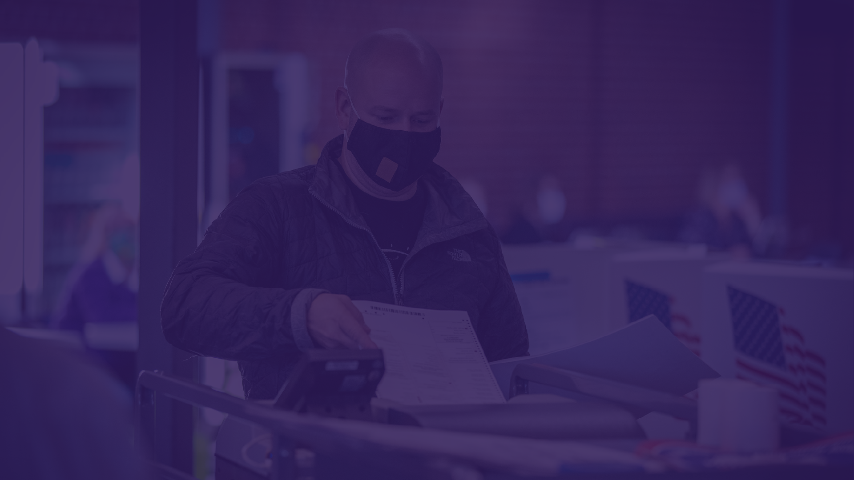
Make a Plan to Vote
Notes:
First, one of the easiest ways to make it more likely that people will actually cast a ballot is to get them to make a plan to vote.
There’s data to back this up. In one study, researchers saw increased turnout simply by asking voters what time they would vote, where they would be coming from, and what they would be doing beforehand. Thinking through these logistics ahead of time reduces the perceived barriers of voting.
Resource: Nickerson, David W., and Todd Rogers. 2010. “Do You Have a Voting Plan? Implementation Intentions, Voter Turnout, and Organic Plan Making.” Psychological Science 21(2): 194–99. From Ideas42: https://www.ideas42.org/wp-content/uploads/2017/05/Students_into_Voters.pdf

Slide 19
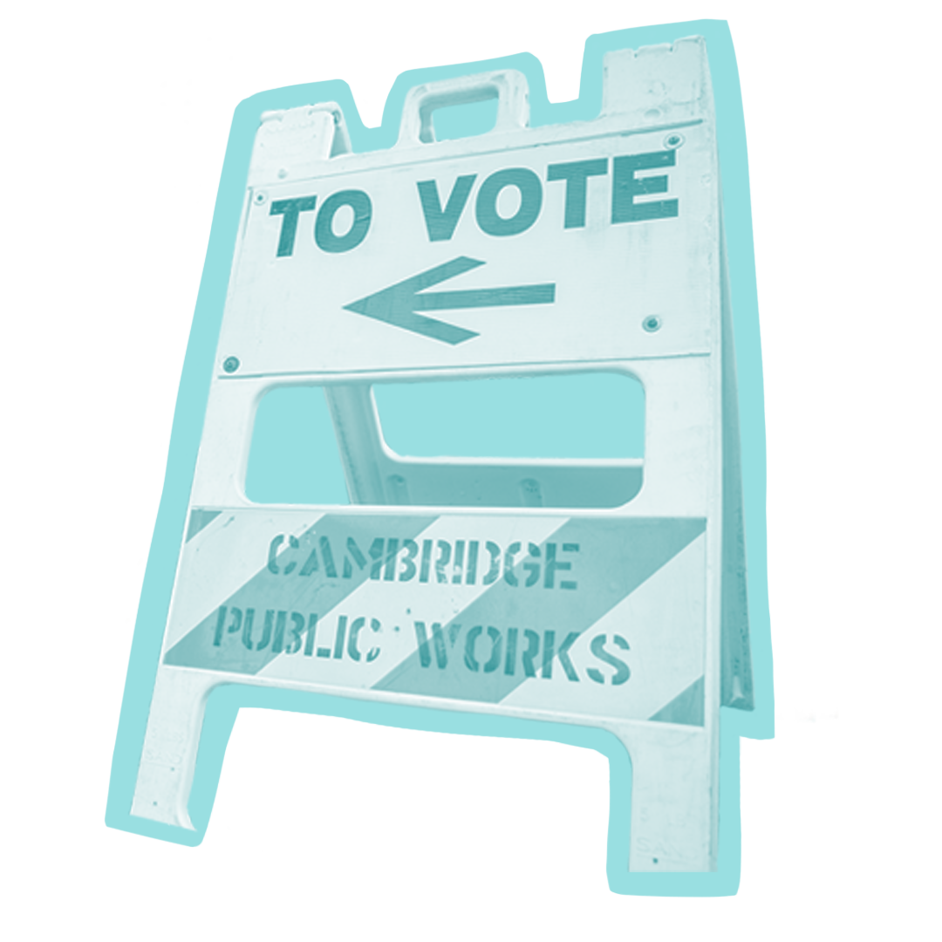
Make a plan to vote!
Get others to do the same!
Make it concrete:
When will you vote?
How will you get there?
How will you prepare (what will you bring with you)?
If voting by mail:
Do you need to request a ballot, and if so do you know how?
When will you sit down to fill it out?
When and how will you mail it?
Do you need a stamp?
Notes:
So in order to increase the likelihood of your friends, family, peers, or colleagues voting, walk through these questions.
This study was conducted pre-pandemic so there was more of a focus on voting in-person, but the same tactics would apply for voting by mail—when will you sit down to fill out your ballot, when/how will you mail it, do you have stamps and if not do you know where to get them (especially for younger voters), etc.
The key here is to make it as concrete as possible (without being too onerous, of course). Ask specific questions that will help people create their voting plan.

Slide 20
Add in a Who-Are-You-Voting-For Plan
Do you have a voting plan?
What about a who-are-you-voting-for plan?
How you can prepare:
Get a sample ballot (ballotpedia.org and ballotready.org)
Read the platforms of local candidates
Research any ballot measures (propositions, initiatives, referendums)
BallotReady.org offers voter guides and you can even print or email your choices to bring to the polls.
Notes:
Of course, it’s one thing to make a plan to cast your ballot, and it’s another to decide who and what you’re voting for!
To take the make-a-plan-to-vote technique to the next level – and increase the likelihood of people voting even more – you can also encourage people to add in a ‘who-are-you-voting-for’ plan.
To do so, Engineers and Scientists Acting Locally, is a nonpartisan nonprofit organization, have prepared this set of recommendations for creating a “who are you voting for” plan.
They suggest resources like Ballotpedia.org or BallotReady.org to view voter guides and sample ballots to help you do your research.
Resources:
Ballotpedia.org
BallotReady.org

Slide 21
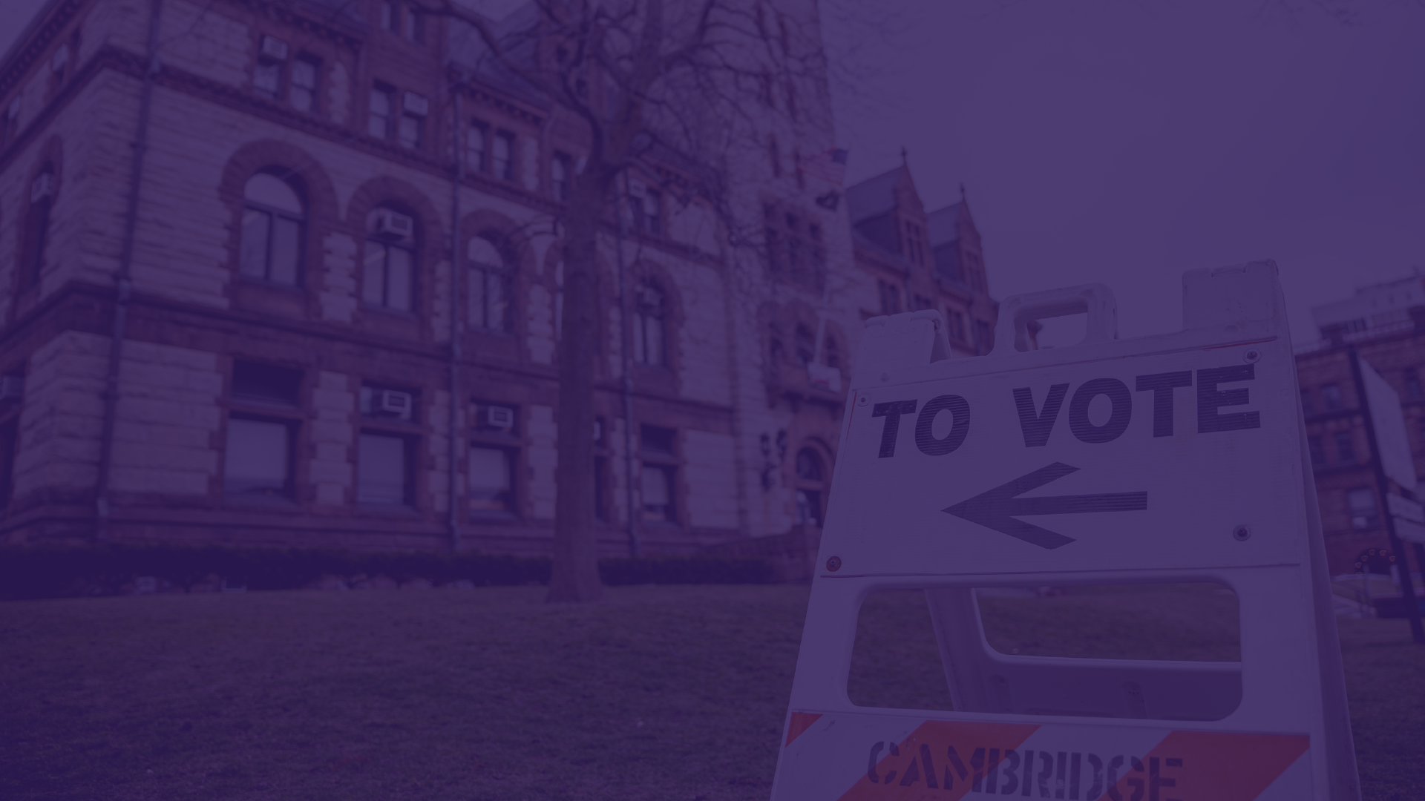
Triple the Vote
Notes:
Next we’ll talk about how you can triple your vote.
The premise of this technique is simple.

Slide 22
Get 3 friends​
to pledge to vote ​
Notes:
Vote tripling means getting three friends to pledge to vote. You can do this by phone, text, social media, or in person.
Resource: https://docs.google.com/document/d/1w0VBbIWKFLx2gtIwdpssyGqnOnXMFaX47JH6d3ZeqQc/edit

Slide 23
Remind them when the time is right
Notes:
Once people pledge to vote, it’s crucial that you then send them a reminder as it gets closer to Election Day.
This works because people are more likely to seriously consider reminders from family and friends than they are campaign volunteers that they don’t know. It also connects to the power of social norms—if you think everyone is voting, you’re more likely to do the same.
Resource: https://docs.google.com/document/d/1w0VBbIWKFLx2gtIwdpssyGqnOnXMFaX47JH6d3ZeqQc/edit

Slide 24
Level up:
Get 3 friends to ask 3 of their friends
Notes:
You can take this technique to the next level by asking 3 friends to ask 3 of their friends to pledge to vote and start a chain reaction of voter mobilization! You can do this right after they pledge to vote themselves or as part of your reminder shortly before Election Day or other important date.
Resource: https://docs.google.com/document/d/1w0VBbIWKFLx2gtIwdpssyGqnOnXMFaX47JH6d3ZeqQc/edit

Slide 25
Continue the Conversation
Notes:
Inspiring, encouraging, and supporting people to participate in our democracy is most effective when it’s part of an ongoing conversation.
So let’s talk about two ways you can do that.

Slide 26
Bring Democracy into the Classroom
Include reminders on basic nonpartisan voter information (key dates, how to register, polling locations, etc.)
Highlight how voting and participation in our democracy is the norm
Encourage civil and productive discourse on how science intersects with societal issues
Notes:
First, if you’re at a college, university, or other academic setting consider ways that you can bring participation in our democracy into the classroom.
One of the easiest ways to do this is to share and highlight the essential nonpartisan information and dates that any voter needs to know to cast a ballot. This includes relevant dates and deadlines for voter registration and elections, local polling station locations, and more. This information can be included in course materials, featured on screen using the template slide that was shared earlier in this presentation, or a variety of other ways. Students can reach out to their professors and teaching assistants to explore the best ways to do this.
As part of this, students and educators alike should emphasize that voting and participation in our democracy is the norm, not the exception. Highlighting that a majority of student voters cast a ballot in recent elections is one easy way to do this.
To more fully engage students in how science intersects with societal issues and our democracy, consider dedicating time to in-class discussions that explore how science informs and shapes policy decisions that affect our everyday lives. This does require care to do in a way that encourages civil and productive discourse.
For more on these techniques, along with other ways to bring democracy into the classroom, see 6 Ways STEM Educators Can Enhance Student Engagement in Our Democracy: https://blog.ucsusa.org/alyssa-shearer/6-ways-stem-educators-can-enhance-student-engagement-in-our-democracy/

Slide 27
Engage in One-on-One Conversations
Look for points of connection (shared values, love of family/community, etc.)
Keep a calm, nonjudgmental attitude
Prioritize empathy over expertise. Seek understanding.
Look for and acknowledge underlying concerns
Talk about solutions in ways that speak to those concerns
Notes:
The second way to continue the conversation is to actively and intentionally engage in one-on-one conversations, including—even especially—with people who may not share the same views and perspectives you hold.
To make these one-on-one conversations as helpful and productive as possible, it’s important to keep a few key things in mind.
Look for points of connection (shared values, love of family/community, etc.). This allows you to establish common ground and a strong foundation to build from in the conversation.
Keep a calm, nonjudgmental attitude. The goal of the conversation isn’t to pass judgment on the other person’s views or concerns or hammer on your own take on things. Similarly, don’t get angry, escalate, or otherwise over-react if the other person shares something you disagree with. All of these approaches are likely to quickly derail and shut down the conversation.
Instead prioritize empathy over expertise. Seek understanding. Why does the other person think or feel the way they do?
Look for and acknowledge underlying concerns. As you gain a better understanding, try to identify the underlying concerns that shape their perspectives and opinions.
Once you’ve gained a sense of their underlying concerns, talk about solutions in ways that speak directly to those concerns.
For more on these techniques, Effective One-on-One Meetings for Mobilizing People into Action for Voting Rights: https://ucs-documents.s3.amazonaws.com/science-and-democracy/Voting-Rights-Mobilization-Guide.pdf

Slide 28
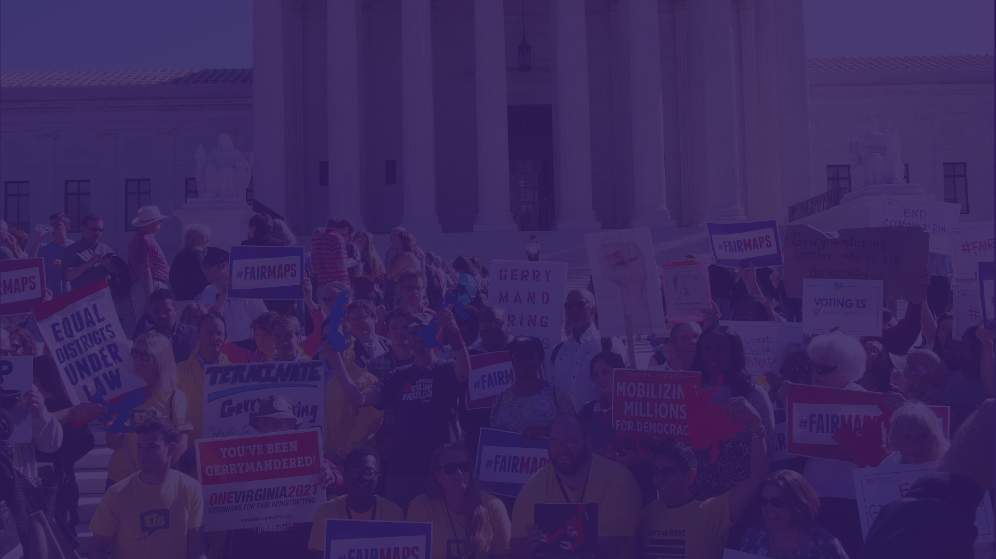
More Ways to Increase Voter Turnout
Notes:
We encourage you to focus on the three techniques we just outlined, but there are of course many other ways to mobilize voters.
So here are a few other evidence-based ways to increase voter turnout. (TRAINERS: Consider adding any techniques you think would be most useful or relevant to your audience).

Slide 29
Host a Voting Study Party
Bring people together to learn about what's on their ballot through research and collaborative discussion.
Notes:
A Voting Study Party is a place where you can learn about all the stuff on your ballot. Together with friends, you can research and unpack the candidates and propositions on your ballot to make informed decisions when you vote. This is especially critical for local candidates and measures, because state and local politics have the biggest and most direct everyday impact on voters’ lives.
Anyone can host a voting study party! As a host, you set the tone for how participants will show up and engage, so make sure you start with clear intentions.
You can host a voting study party in-person anywhere with solid wifi for doing online research. You can also host online. Wherever you host, make sure you think through logistics and how you'll ensure participants feel connected with each other and the issues on their ballot.
Why do this? Through research and discussion, you’ll accomplish two key outcomes: 1. You’ll collectively develop a “local voter guide” -- a shared document with all your party notes! It’ll be there to help when filling out ballots so participants don’t have to remember everything discussed, and they can also share it with other folks who weren’t able to make it. 2. Ultimately you’re helping to build a more civically engaged electorate. Together, your mission (should you choose to accept it) is to collectively understand who is running, what is being proposed, and how these policies and players will affect you and the people around you.
Keep in mind: the goal of a Voting Study Party is not to sway others to your line of thinking. Diversity in opinion is awesome, and capturing that diversity of thought is the whole point of a democracy! You don’t want to scare new and/or tepid voters from participating in their government with judgmental opinions or divisive comments.
When to do this: This is a great activity leading up to both primaries and the general election, once it's clear what will actually be on your ballot.
Check out Voting Study Party for a detailed guide: https://www.votingstudyparty.org/hosting.html
Resource: https://www.votingstudyparty.org/hosting.html

Slide 30
Be a Poll Worker
Poll workers receive training (and sometimes paid compensation) to staff our elections and keep our democracy running smoothly.
Notes:
In 2020, America faced a nationwide poll worker shortage.​ This presented a crisis, and an opportunity for younger voters to step up and work the polls.
Poll workers work for election administrators to help administer the election. They do things like check in voters, fix voting machines, and troubleshoot any other issues at polling sites.​
Who qualifies as a poll worker varies by each jurisdiction. Many states require poll workers to be registered to vote in the state or their local jurisdiction. In some cases, younger people who aren’t yet eligible to vote can also serve as poll workers. In most states you cannot work the polls unless you are a registered voter and citizen. The best place to find guidance is with your local administrator.​
If you’re interested, start with your local or county election administrator, or Secretary of State website. While some jurisdictions allow individuals to travel and work the polls even if they are not registered to vote in that location, for the most part, individuals are only allowed to serve in the state where they reside.​
You can also check out Power the Polls to find out where there are opportunities for you to be a poll worker.​
​
Resource: https://www.powerthepolls.org/about​​

Slide 31
Write Letters to Encourage Turnout
Personalized, handwritten, nonpartisan letters to voters can be an effective way to increase voter turnout and strengthen our democracy
Notes:
Writing personalized, handwritten, nonpartisan letters to registered voters can boost voter turnout by as much as 3.4 percentage points. Several online efforts can provide a list of voters you can write letters to, as well as step by step guidance to walk you through the process.
This is a great activity to do with a group of friends, and you can discuss your ideas for how to personalize these messages and encourage people to vote.
[Resource: one example is Vote Forward https://votefwd.org/]

Slide 32
Voter Suppression and Disinformation
Notes:
To close, I wanted to highlight another striking demonstration of the power and momentum of the student vote.
And that is the growing efforts by anti-democratic forces to suppress the student vote using a range of tactics, including the use of disinformation.
You can read about the 4 primary ways this is happening in this recent blog post--4 Tactics Anti-Democratic Forces Are Using to Suppress the Student Vote: https://blog.ucsusa.org/ingrid-paredes/4-tactics-anti-democratic-forces-are-using-to-suppress-the-student-vote/--but I wanted to focus specifically for a minute on disinformation—false and misleading information intentionally spread for political or financial gain.

Slide 33
Voter Suppression and Disinformation
Bad actors use disinformation to suppress voter participation and turnout. Disinformation increases as elections get closer
Bad actors often specifically target Black, Indigenous, and other communities of color to keep them away from the polls.
Disinformation is often specifically designed to intim­id­ate voters with false reports of law enforce­ment pres­ence, immig­ra­tion enforce­ment actions, or elec­tion monit­or­ing by armed indi­vidu­als.
Notes:
Why focus on disinformation? Because in the run up to the 2024 election, bad actors will almost certainly use disinformation in an effort to suppress voter participation and turnout.
In the United States, there is a long history of bad actors using decept­ive prac­tices to spread false inform­a­tion in an attempt to trick people out of voting, particularly to keep Black, Indigenous, and other communities of color or marginalized communities away from the polls. Now student voters are coming under attack as well.
There is a multi­tude of stor­ies about attempts to trick certain people out of voting. These decept­ive prac­tices have often involved the use of flyers, mail­ers, and robocalls. In 2004, flyers distrib­uted in Frank­lin County, Ohio, falsely told voters that Repub­lic­ans should vote on Tues­day and Demo­crats on Wednes­day due to high levels of voter regis­tra­tion. A related tactic is to intim­id­ate voters with false reports of law enforce­ment pres­ence, immig­ra­tion enforce­ment actions, or elec­tion monit­or­ing by armed indi­vidu­als. These voter suppres­sion tactics frequently target histor­ic­ally disen­fran­chised communit­ies. For example, on Elec­tion Day in 2010, Mary­land gubernat­orial candid­ate Bob Ehrlich’s campaign manager targeted African Amer­ican house­holds with robocalls claim­ing that Governor Martin O’Mal­ley had already been reelec­ted, imply­ing that his support­ers could stay home instead of voting.
Resource: https://www.brennancenter.org/our-work/research-reports/digital-disinformation-and-vote-suppression

Slide 34
What are the Consequences of Voter Suppression?
Worse public health and safety outcomes, weaker environmental protections, and racist and inequitable policies.
Notes:
What does voter suppression have to do with science? The evidence shows that public health and safety outcomes are worse in communities where voter suppression has occurred, and voters are systematically excluded from the process. Environmental protections are weaker or non-existent and environmental justice is not achieved.
Over the last decade, public health has become increasingly tied to the health of our democracy. Life expectancy has been declining for the first time in nearly a century. At the same time, many state legislatures have insulated themselves from public accountability through extreme partisan gerrymandering and restrictive election laws. Biased, unrepresentative state legislatures have been less likely to expand access to health care, and health disparities in those states have continued to worsen, especially for communities already under greater social distress. The United States needs to restore and improve electoral integrity and political equality in state legislatures to address growing inequalities and empower communities to protect themselves.
Restrictive election laws distort representation to favor entrenched, powerful interests. This has not only weakened environmental regulations (possibly leading to poorer air quality in many communities) but also weakened the ability of citizens in these communities to preserve or enact local environmental protections. Overall, congressional districts in gerrymandered states exhibit poorer air quality, consistent with the notion that these legislatures are less responsive to communities that suffer the burdens of unregulated environmental degradation.
Resources:
https://blog.ucsusa.org/andrew-rosenberg/scientists-get-involved-in-democracy-reform
https://www.ucsusa.org/sites/default/files/2019-10/ucs-es-voting-10-19-web.pdf
https://www.ucsusa.org/sites/default/files/attach/2018/09/building-a-healthier-democracy-report.pdf

Slide 35
Voter Suppression and Disinformation: What You Can Do About It
Inoculate others before disinformation spreads
Regularly amplify correct information and trustworthy sources of information
DO NOT AMPLIFY, SHARE, OR PROMOTE DISINFORMATION
Report disinformation when you see it:
To Election Protection: 866-OUR-VOTE.
To the platforms themselves
Notes:
Now the good news: There’s a lot you can do to protect your networks and campus against disinformation and voter suppression tactics.
First, you can alert others that election-related disinformation is going to increase as the election draws closer—and to keep their radars up for potential falsehoods they might encounter. To be most effective, this should happen before specific points of disinformation begin to circulate—evidence shows that simply priming people to be watchful for disinformation makes it less likely that they will be fooled by it.
Second, regularly amplify correct information and trustworthy sources of information. Highlight accurate information and sources rather than wasting time trying to debunk or counter specific points of disinformation.
Third, do not do the work of the bad actors for them! As a general rule, don’t help them spread their lies and falsehoods by amplify, sharing, or promoting the disinformation in any way, even if it’s to debunk, ridicule, or warn people about it specifically.
Lastly, watch for voter suppression tactics like spreading disinformation about voting and the election as the elections draw closer. If you have questions about election-related information, or think you see voter suppression tactics, confirm the correct information through trusted sources like the Brennan Center for Justice, your Secretary of State’s website, or for students, Campus Vote Project.
If you do confirm that it is disinformation, and it is being spread on a wide scale, report it to Election Protection. Elec­tion Protec­tion is a national nonpar­tisan coali­tion that main­tains rela­tion­ships with elec­tion offi­cials across the coun­try. You can visit their website or call 866.OUR.VOTE. Elec­tion protec­tion volun­teers will record incid­ents, look for patterns, and help pass inform­a­tion to inter­net compan­ies, offi­cials, and ulti­mately affected communit­ies and indi­vidu­als.
Resource: https://www.brennancenter.org/our-work/analysis-opinion/voters-vs-disinformation

Slide 36
Additional Resources
Voting information by state
VOTE 411
Campus Vote Project
TurboVote: sign up for election-related reminders
Find early voting locations and your Election Day polling place at GetToThePolls.com.
More resources on campus engagement efforts: Students Learn Students Vote Resource Library
Notes:
**presenters: feel free to add state or local resources here
Voting information by state
VOTE 411: https://www.vote411.org/
Campus Vote Project: https://www.campusvoteproject.org/
TurboVote: sign up for election-related reminders: https://turbovote.org/
Find early voting locations and your Election Day polling place at GetToThePolls.com.: https://gettothepolls.com/
Find plenty more resources on campus engagement efforts and more at Students Learn Students Vote Resource Library: https://slsvcoalition.org/resource-library/

Slide 37
Questions?
Notes:
**presenters: pause for questions

Slide 38
Closing Activity: Reflect and Take Action
Reflect
What did you take away from this training?
Take action
Text 3 friends to make sure they're registered and planning to vote in the next election (using TurboVote.org)
Notes:
Note to trainer: if you're close to Election Day, you can change the "action" to "make a plan to vote"!

Slide 39
Thank You!
Notes:
END OF TEMPLATE PRESENTATION

